Slide 1
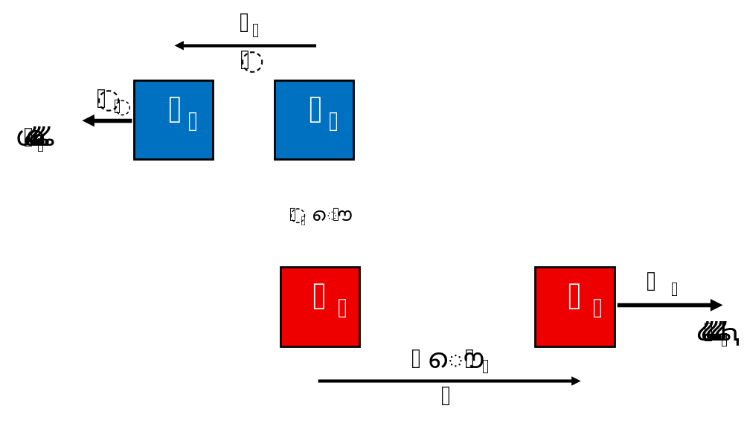
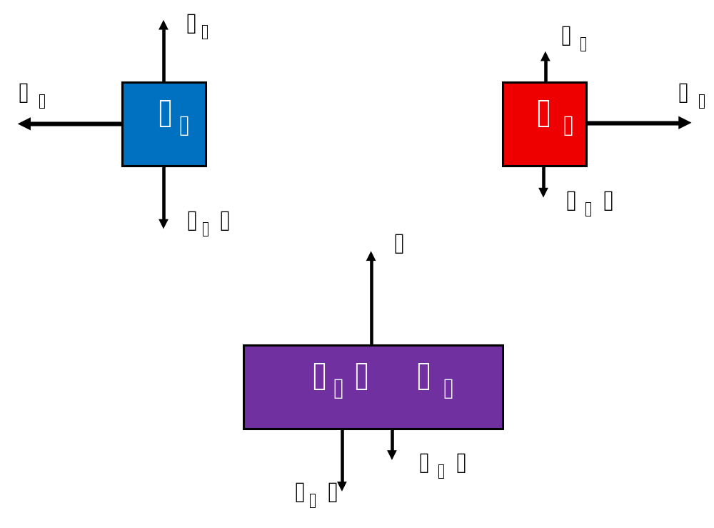
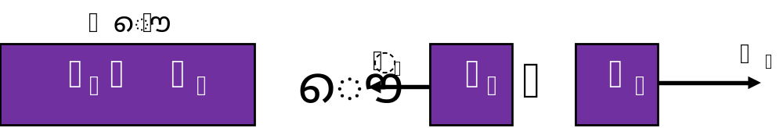

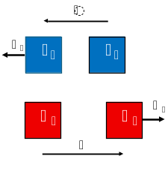
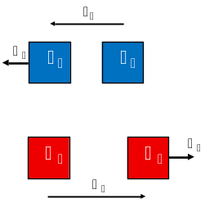
Methodological
Approach
To
Mechanics
Problems
Tom Bright
Physics Educator Symposium on
Research and Teaching
13 June 2026
@BrighterPhysics
Notes:
The internal forces always cancel in pairs. Only the external forces contribute to the net force.

Slide 2
Methodological Approach To Mechanics
  Kinematics, Forces, Momentum, Energy – the base topics for all of mechanics
  Rigorous, consistent, and coherent approach
  A single procedure for each topic is sufficient to successfully approach any problem
  Removes the questions “Where do I start?” and “What do I do next?”
  Provides a solution, not an answer
  Physics forward – pushes math to the end
@BrighterPhysics
Notes:
The internal forces always cancel in pairs. Only the external forces contribute to the net force.

Slide 3
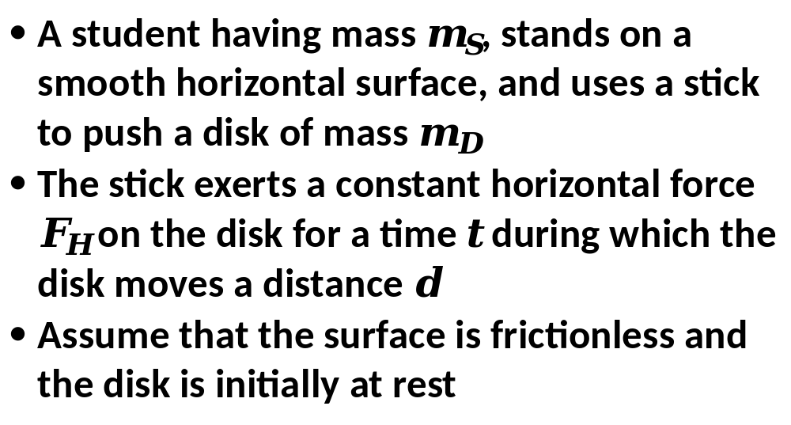
2021
AP Physics 1
Test
(modified)
Example
What can we do with this?
@BrighterPhysics
Notes:
These are the standard definitions that you can find in any peer reviewed Physics textbook. I have found not a single reference to a perfectly elastic collision in any of the college text that I have seen. Sure you can find differing definitions, such as definitions for perfectly elastic collisions, in many placed on the web – but you get what you paid for!

Slide 4
Kinematics
apply kinematic equations to each mass separately
@BrighterPhysics
Notes:
Both the internal and external force may be conservative forces. So, for instance, if the system is two carts on a frictionless ramp and the internal force is an ideal spring, then the PE from gravity and PE from the spring and the total KE add to a constant if there are no friction forces acting.

Slide 5
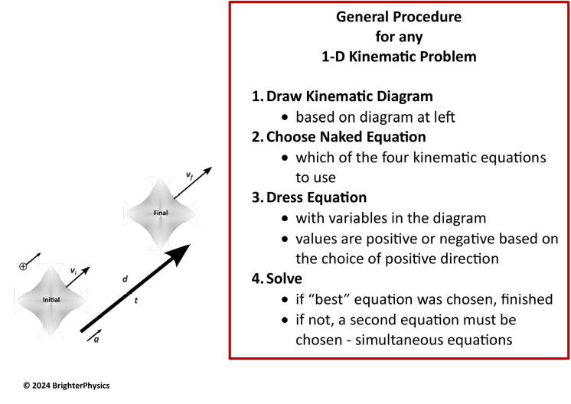
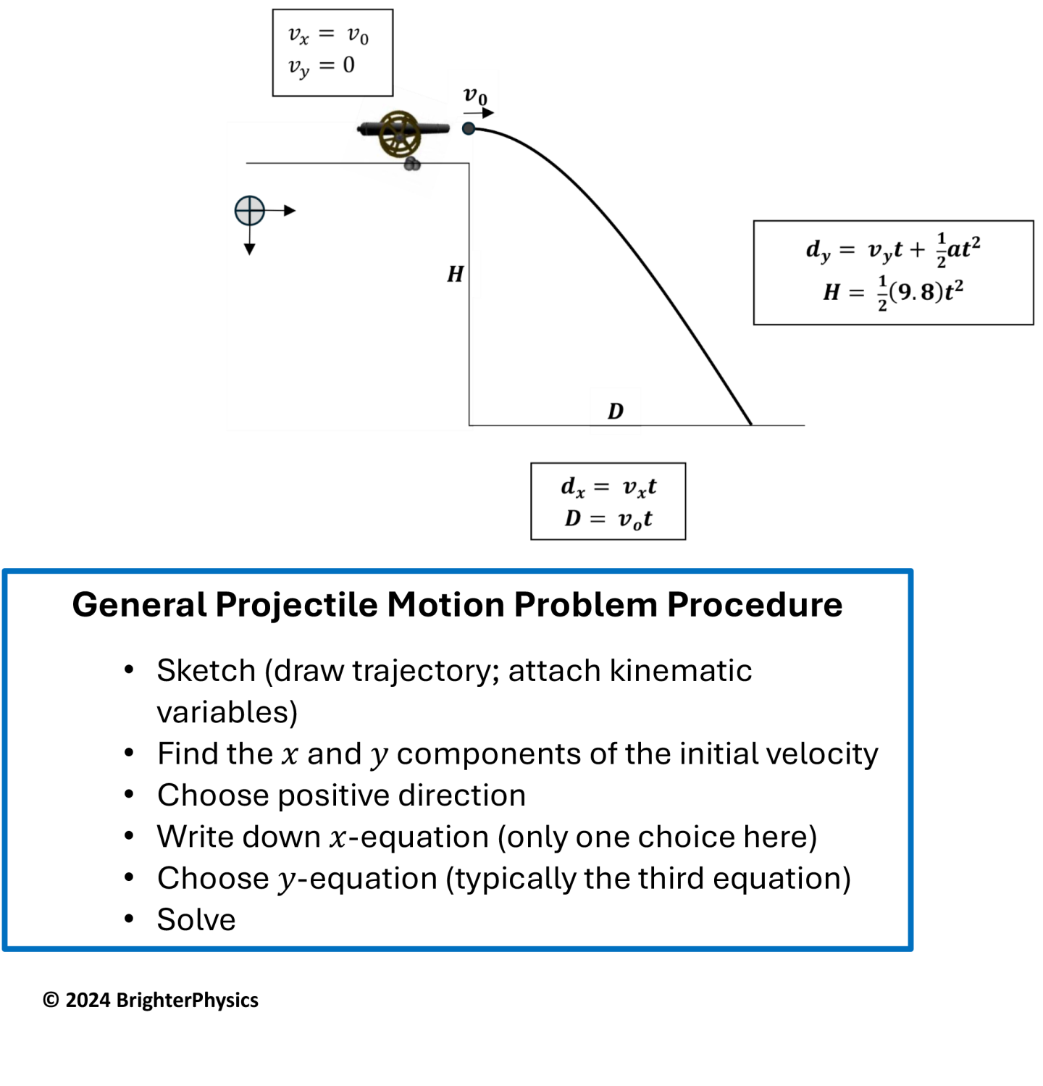
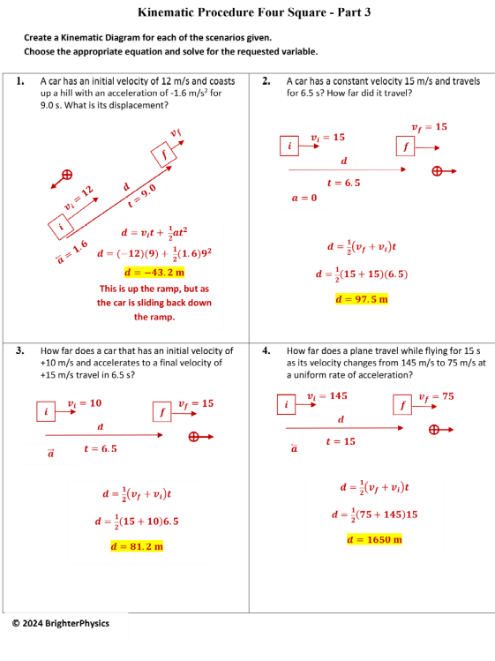
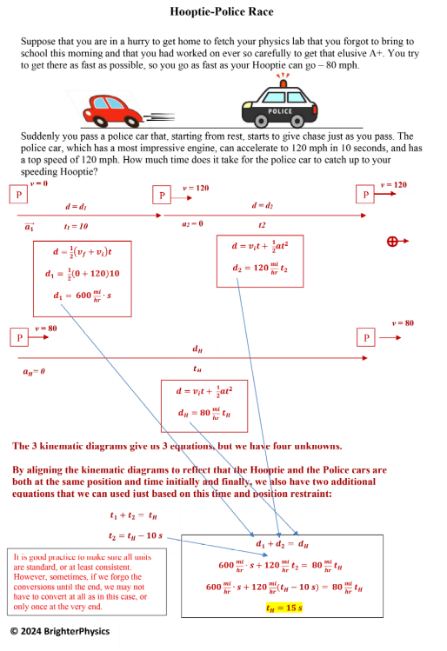
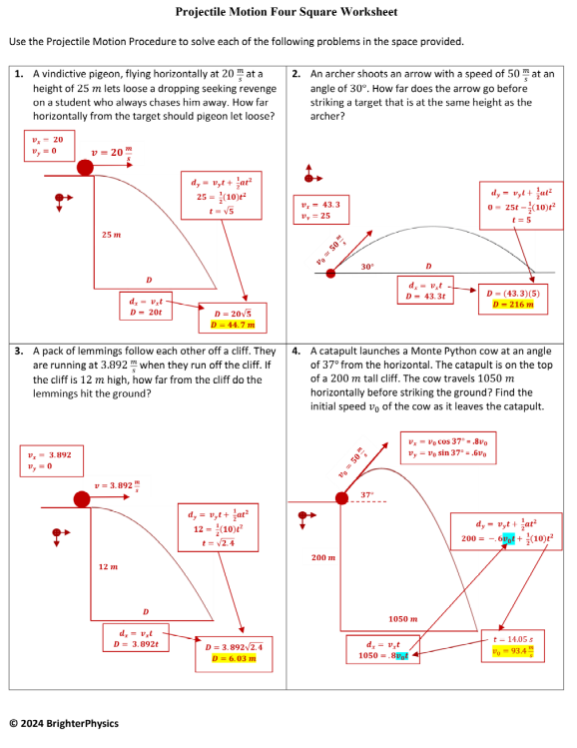
Kinematics Examples
@BrighterPhysics
Notes:
Both the internal and external force may be conservative forces. So, for instance, if the system is two carts on a frictionless ramp and the internal force is an ideal spring, then the PE from gravity and PE from the spring and the total KE add to a constant if there are no friction forces acting.

Slide 6
Forces
apply (vector) 2nd Law to each system separately
@BrighterPhysics
Notes:
Both the internal and external force may be conservative forces. So, for instance, if the system is two carts on a frictionless ramp and the internal force is an ideal spring, then the PE from gravity and PE from the spring and the total KE add to a constant if there are no friction forces acting.

Slide 7
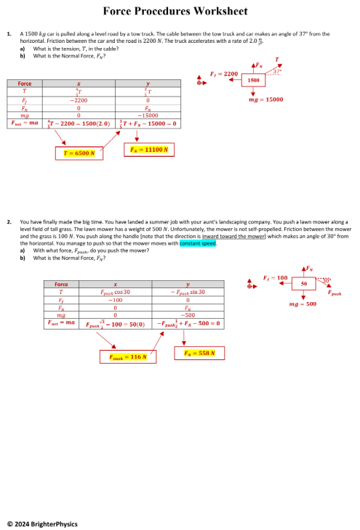
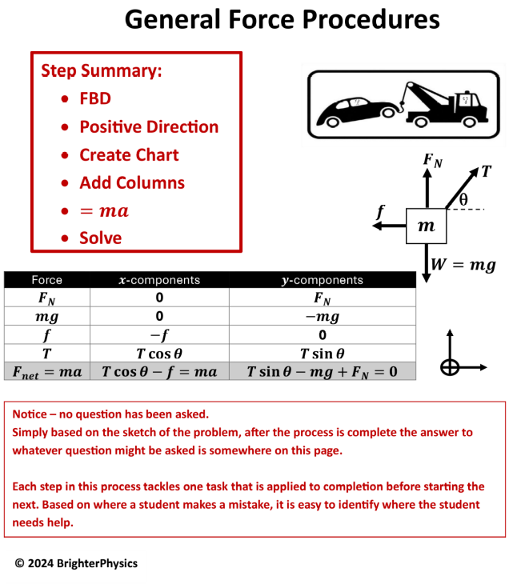
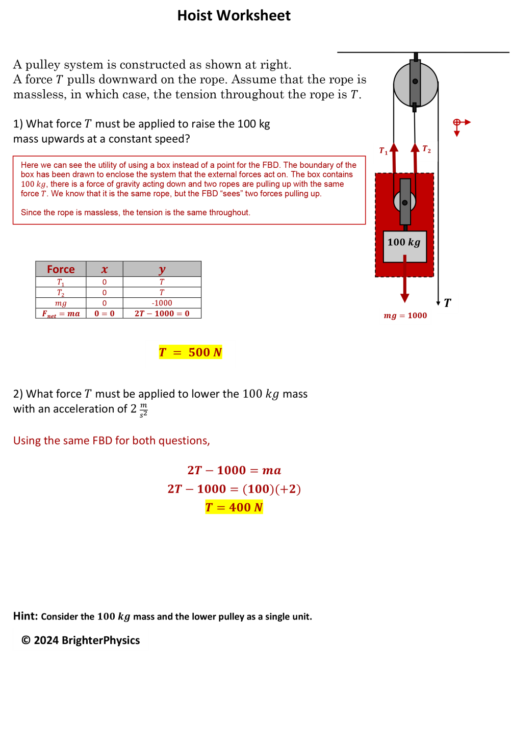
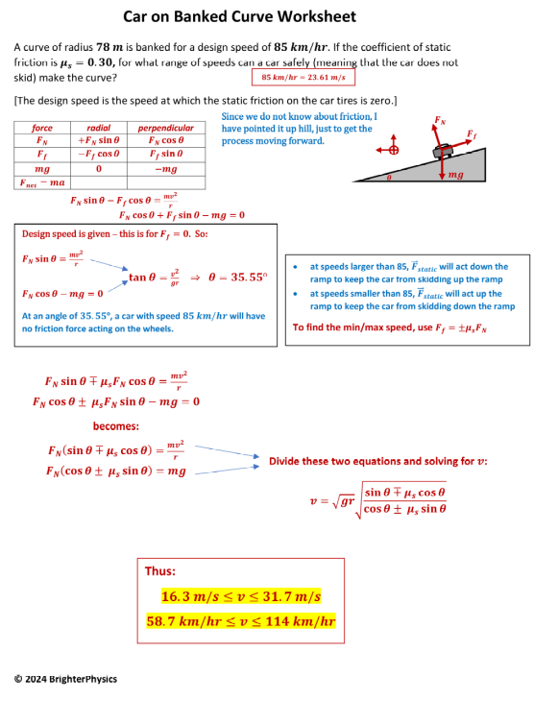
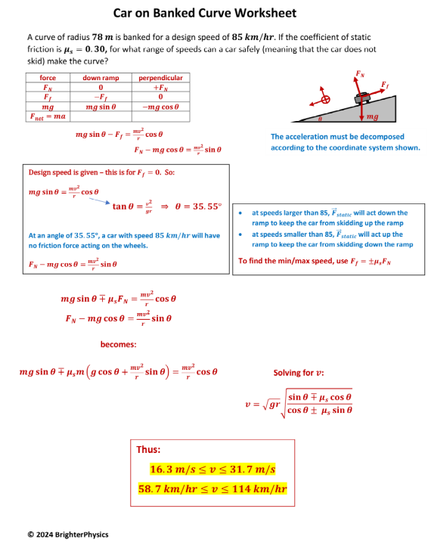
Forces Examples
@BrighterPhysics
Notes:
Both the internal and external force may be conservative forces. So, for instance, if the system is two carts on a frictionless ramp and the internal force is an ideal spring, then the PE from gravity and PE from the spring and the total KE add to a constant if there are no friction forces acting.

Slide 8
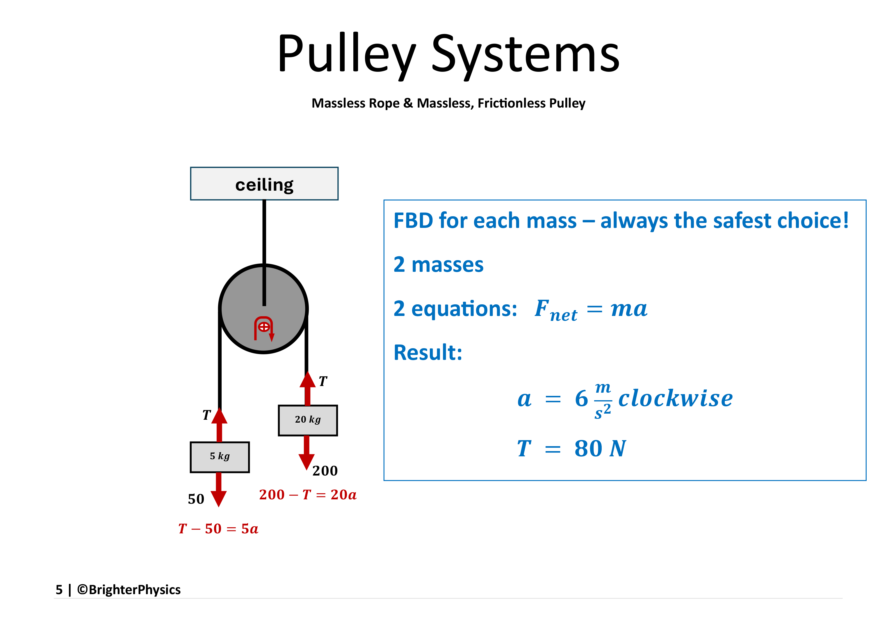
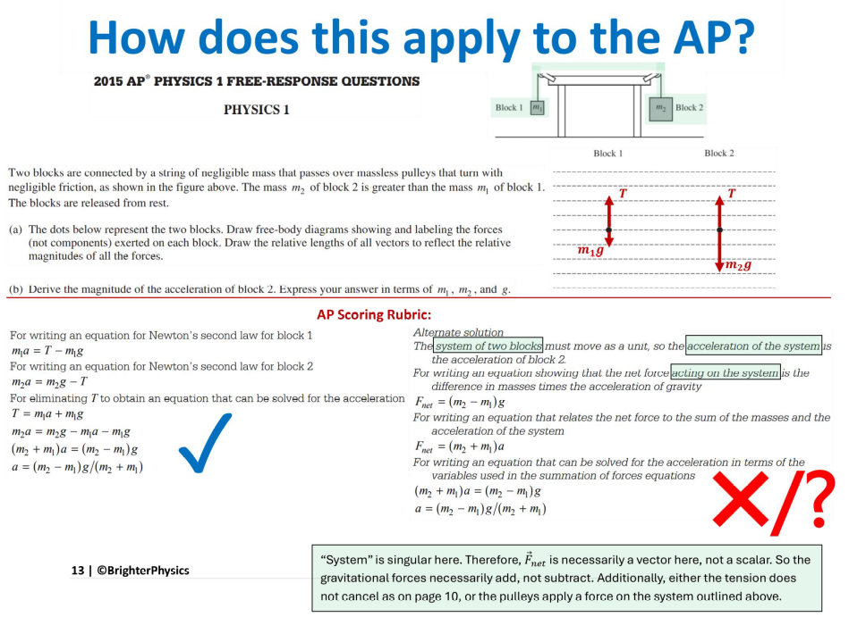
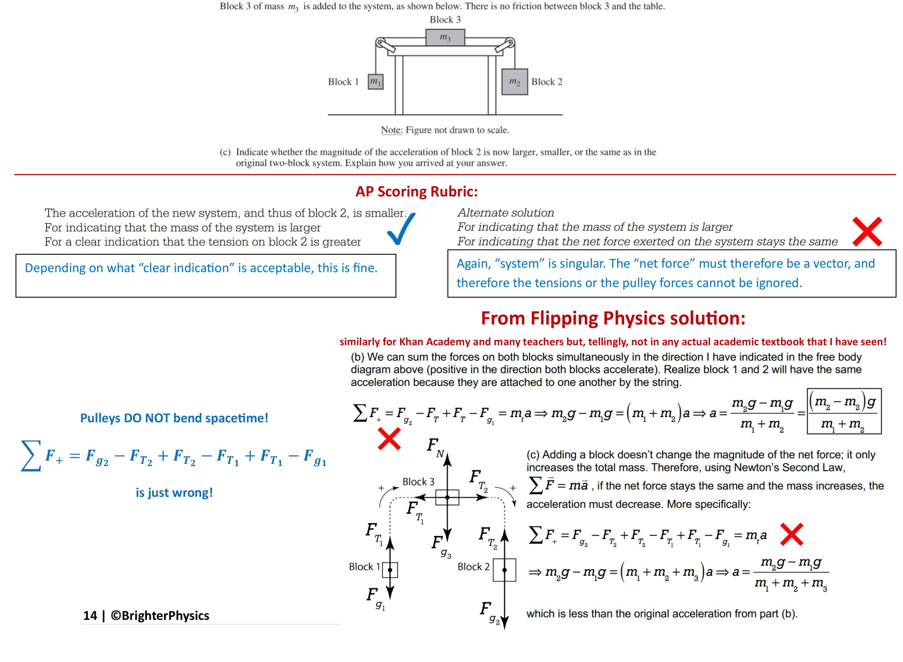
Forces Examples
@BrighterPhysics
Notes:
Both the internal and external force may be conservative forces. So, for instance, if the system is two carts on a frictionless ramp and the internal force is an ideal spring, then the PE from gravity and PE from the spring and the total KE add to a constant if there are no friction forces acting.

Slide 9
Forces Examples
@BrighterPhysics
Notes:
Both the internal and external force may be conservative forces. So, for instance, if the system is two carts on a frictionless ramp and the internal force is an ideal spring, then the PE from gravity and PE from the spring and the total KE add to a constant if there are no friction forces acting.

Slide 10
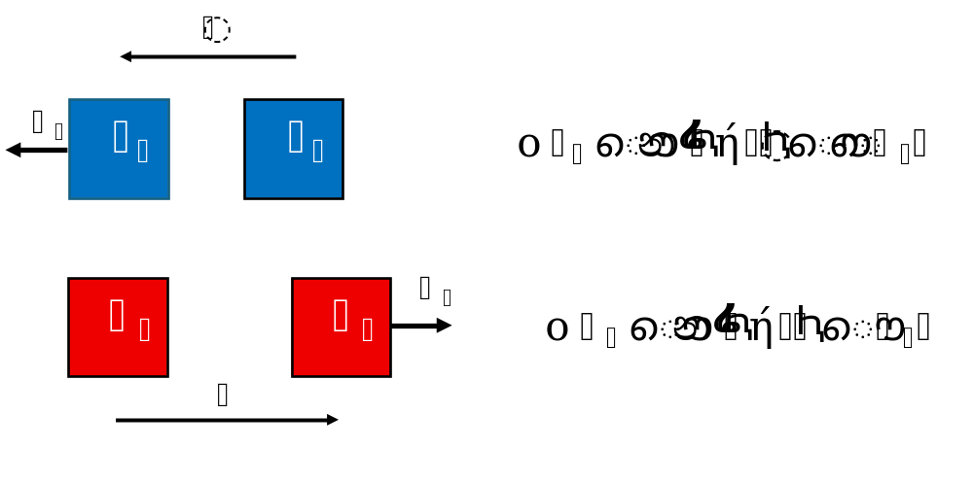
Momentum
apply conservation of momentum if single system
apply impulse-momentum if separate systems
@BrighterPhysics
Notes:
Both the internal and external force may be conservative forces. So, for instance, if the system is two carts on a frictionless ramp and the internal force is an ideal spring, then the PE from gravity and PE from the spring and the total KE add to a constant if there are no friction forces acting.

Slide 11
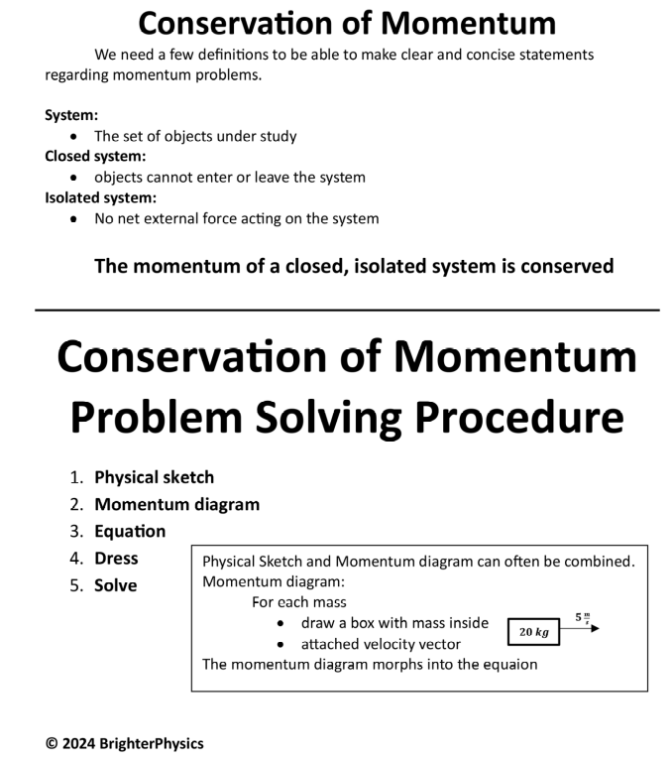
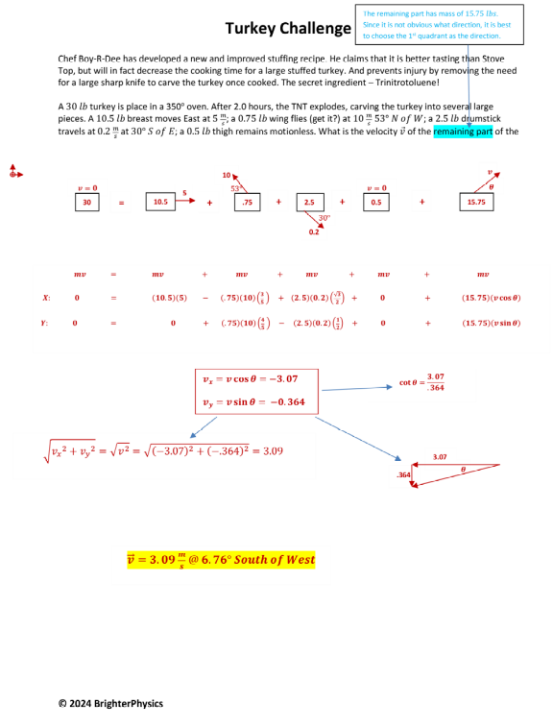
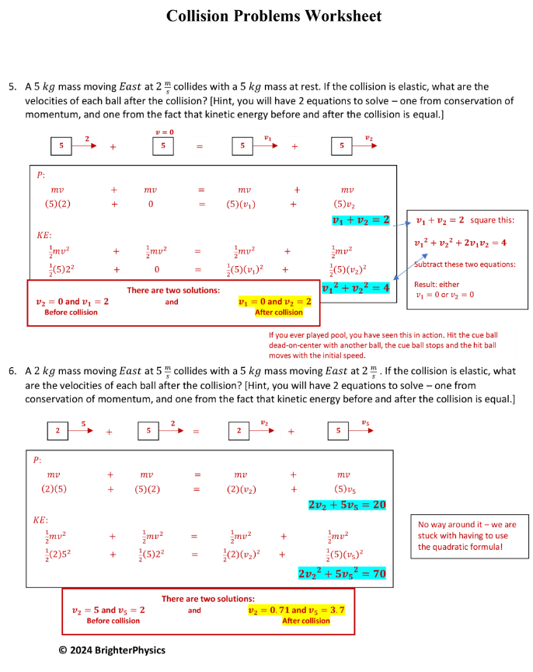
Momentum Examples
@BrighterPhysics
Notes:
Both the internal and external force may be conservative forces. So, for instance, if the system is two carts on a frictionless ramp and the internal force is an ideal spring, then the PE from gravity and PE from the spring and the total KE add to a constant if there are no friction forces acting.

Slide 12
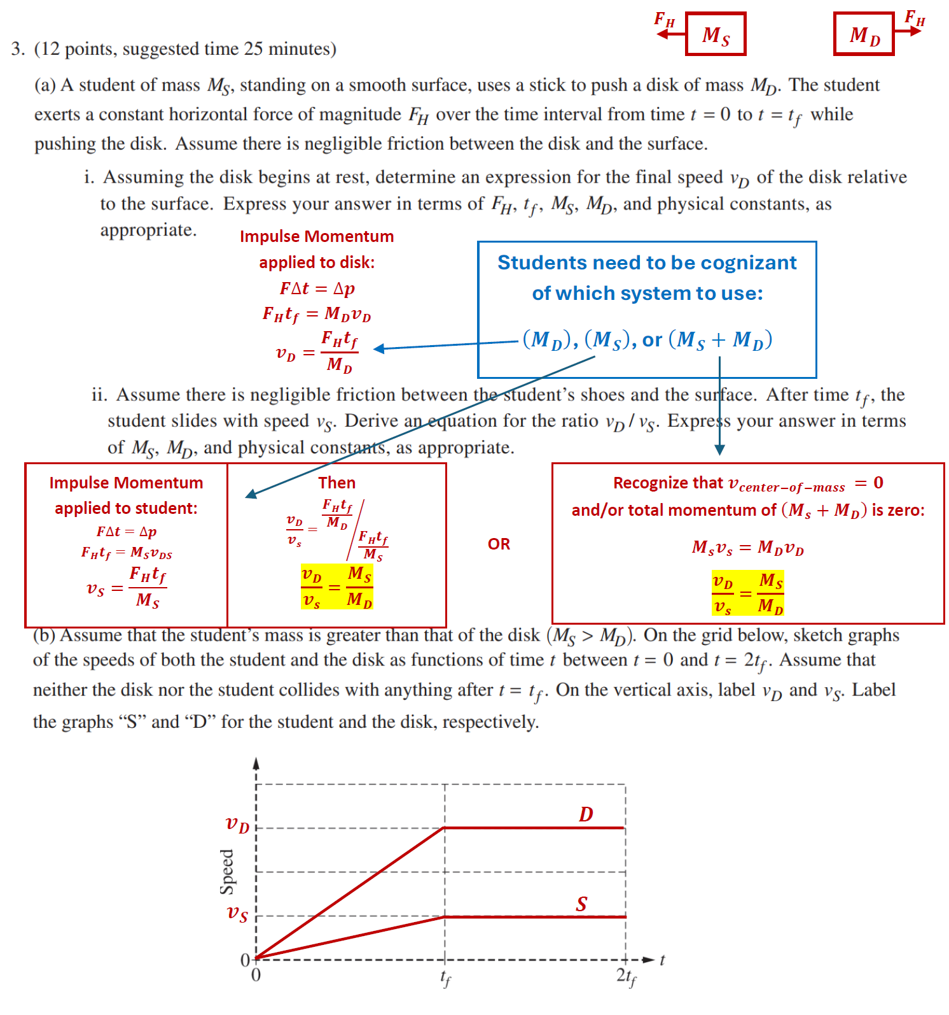
Momentum Examples
@BrighterPhysics
Notes:
Both the internal and external force may be conservative forces. So, for instance, if the system is two carts on a frictionless ramp and the internal force is an ideal spring, then the PE from gravity and PE from the spring and the total KE add to a constant if there are no friction forces acting.

Slide 13
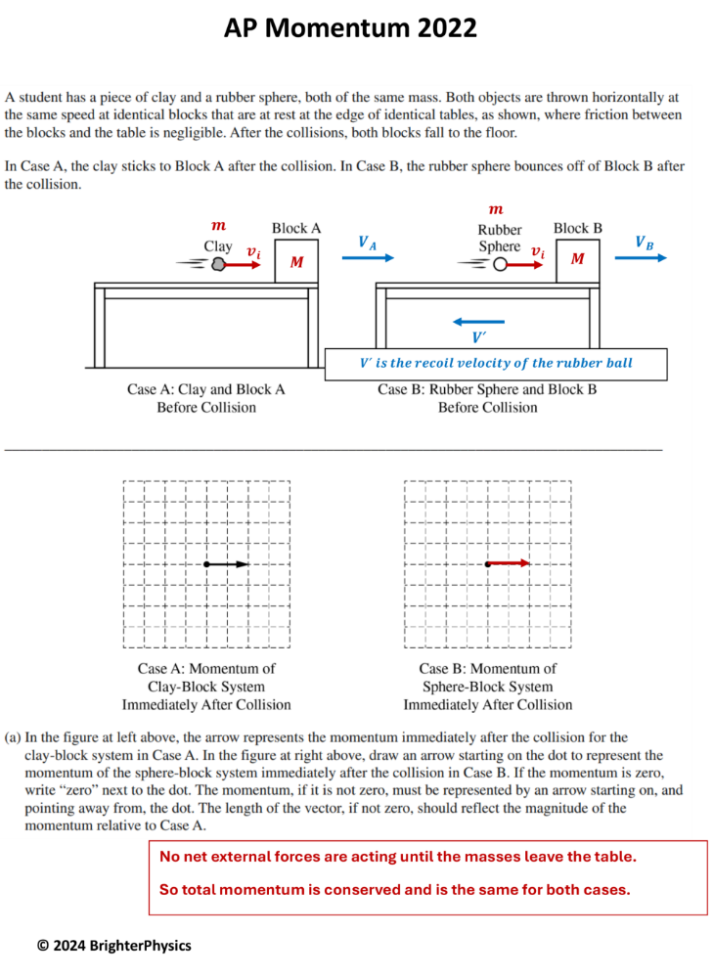
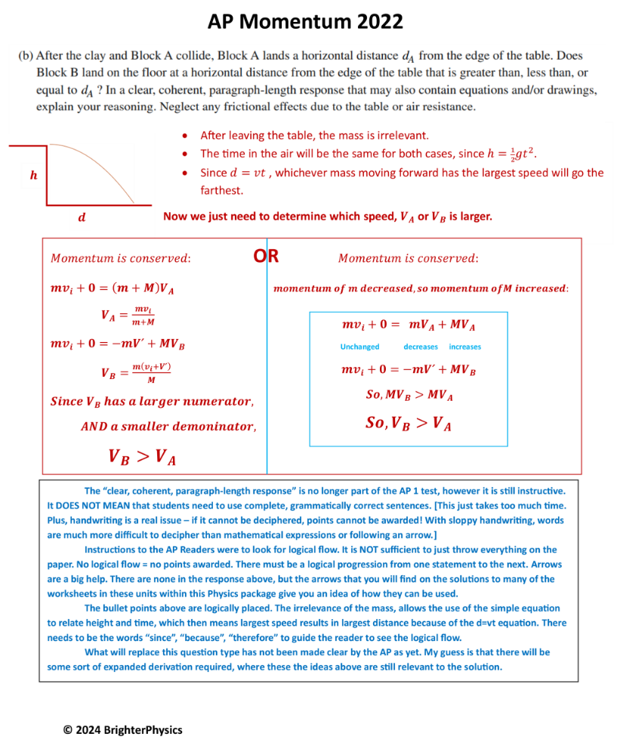
Momentum Examples
@BrighterPhysics
Notes:
Both the internal and external force may be conservative forces. So, for instance, if the system is two carts on a frictionless ramp and the internal force is an ideal spring, then the PE from gravity and PE from the spring and the total KE add to a constant if there are no friction forces acting.

Slide 14
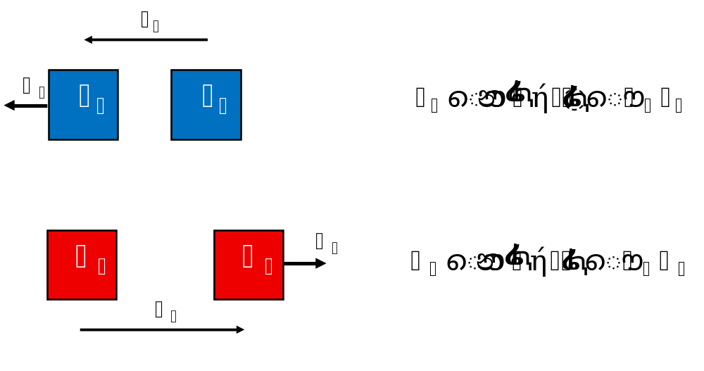
Energy
apply conservation of energy if single system
apply work-energy if separate systems
@BrighterPhysics
Notes:
Both the internal and external force may be conservative forces. So, for instance, if the system is two carts on a frictionless ramp and the internal force is an ideal spring, then the PE from gravity and PE from the spring and the total KE add to a constant if there are no friction forces acting.

Slide 15
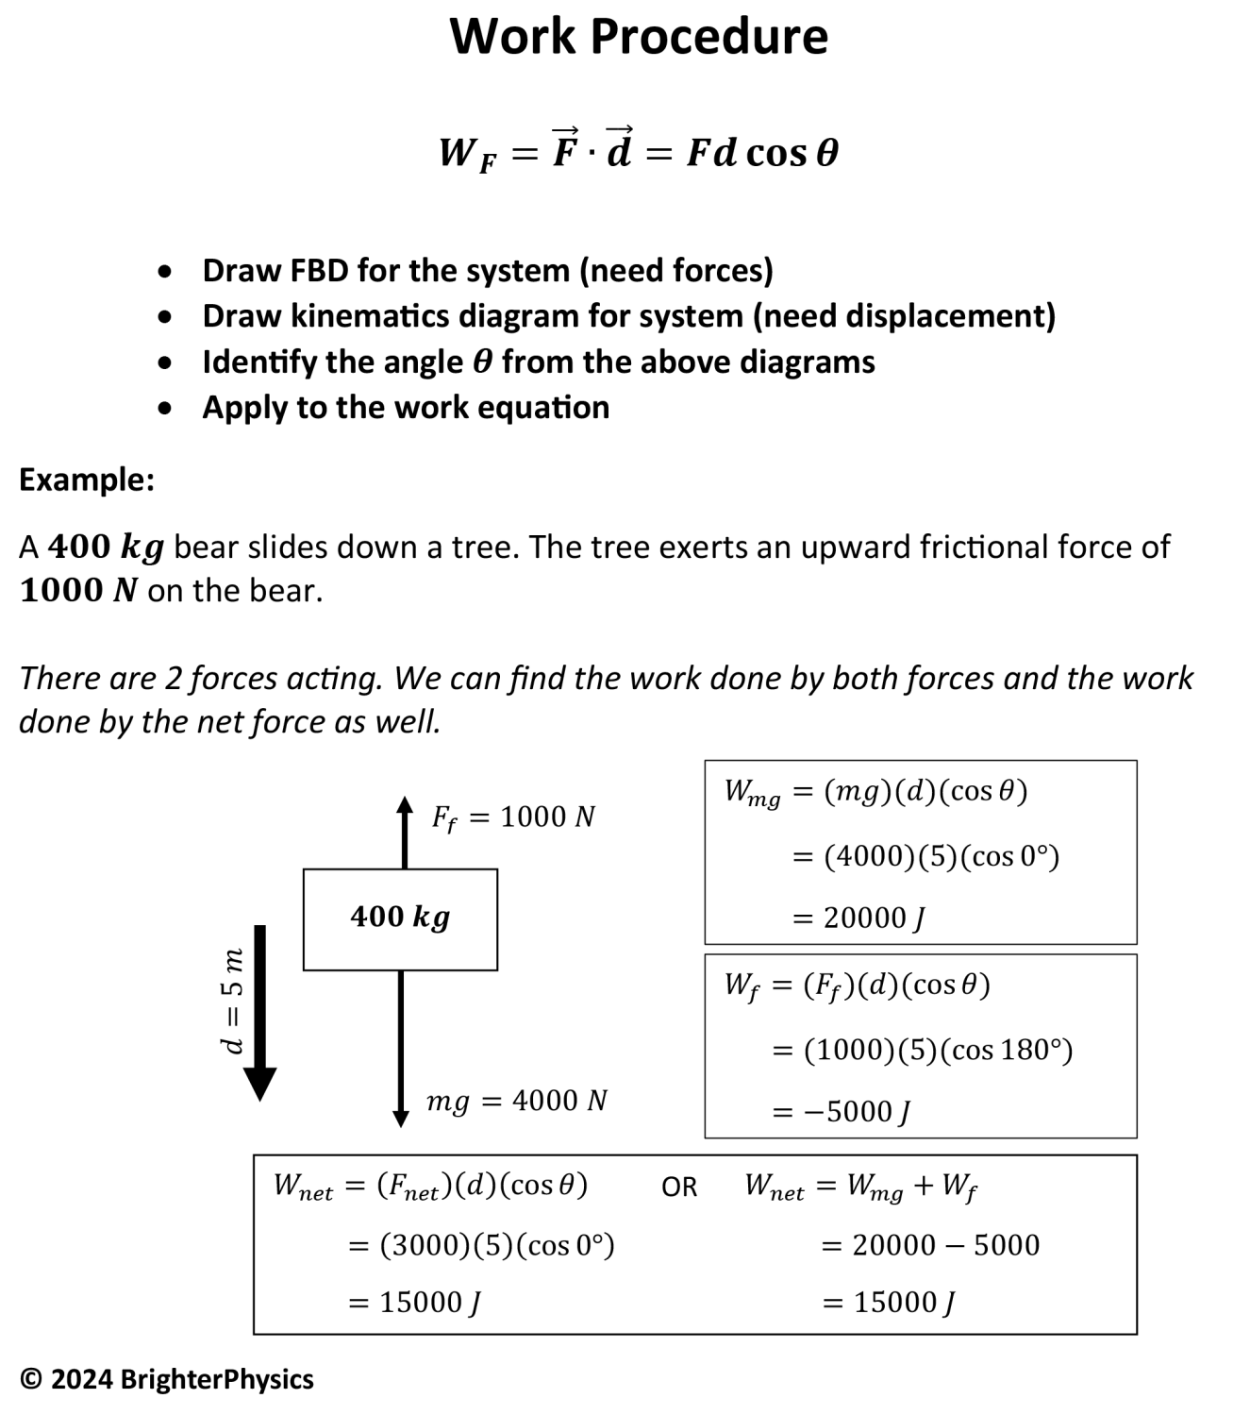
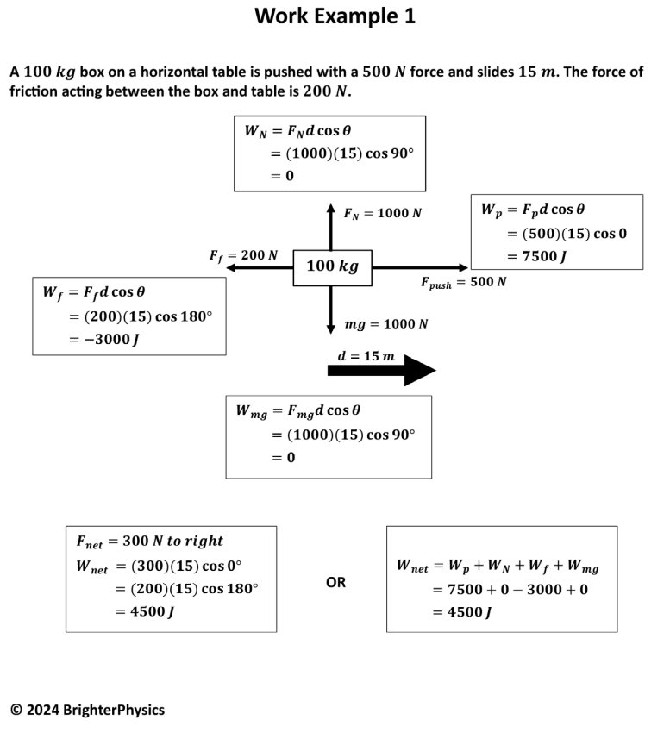
Energy Examples
@BrighterPhysics
Notes:
Both the internal and external force may be conservative forces. So, for instance, if the system is two carts on a frictionless ramp and the internal force is an ideal spring, then the PE from gravity and PE from the spring and the total KE add to a constant if there are no friction forces acting.

Slide 16
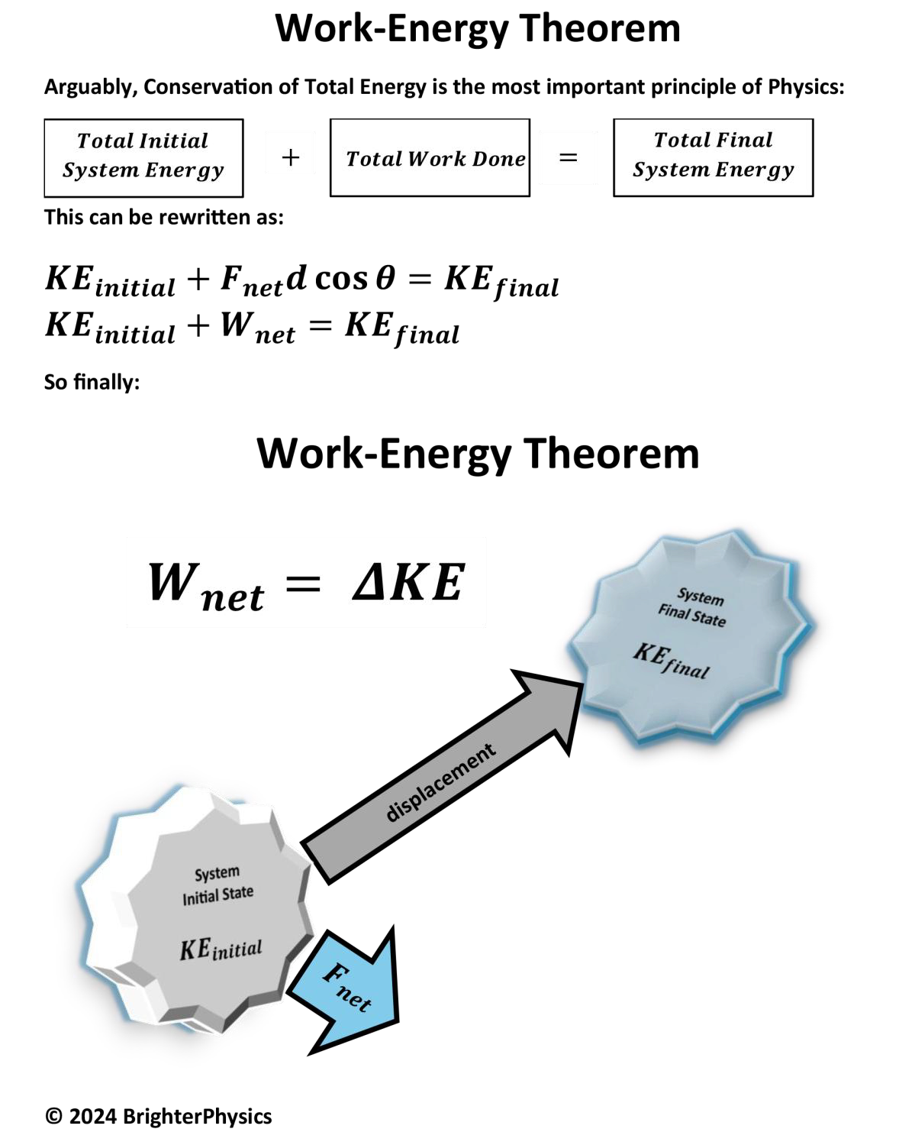
Energy Examples
@BrighterPhysics
Notes:
Both the internal and external force may be conservative forces. So, for instance, if the system is two carts on a frictionless ramp and the internal force is an ideal spring, then the PE from gravity and PE from the spring and the total KE add to a constant if there are no friction forces acting.

Slide 17
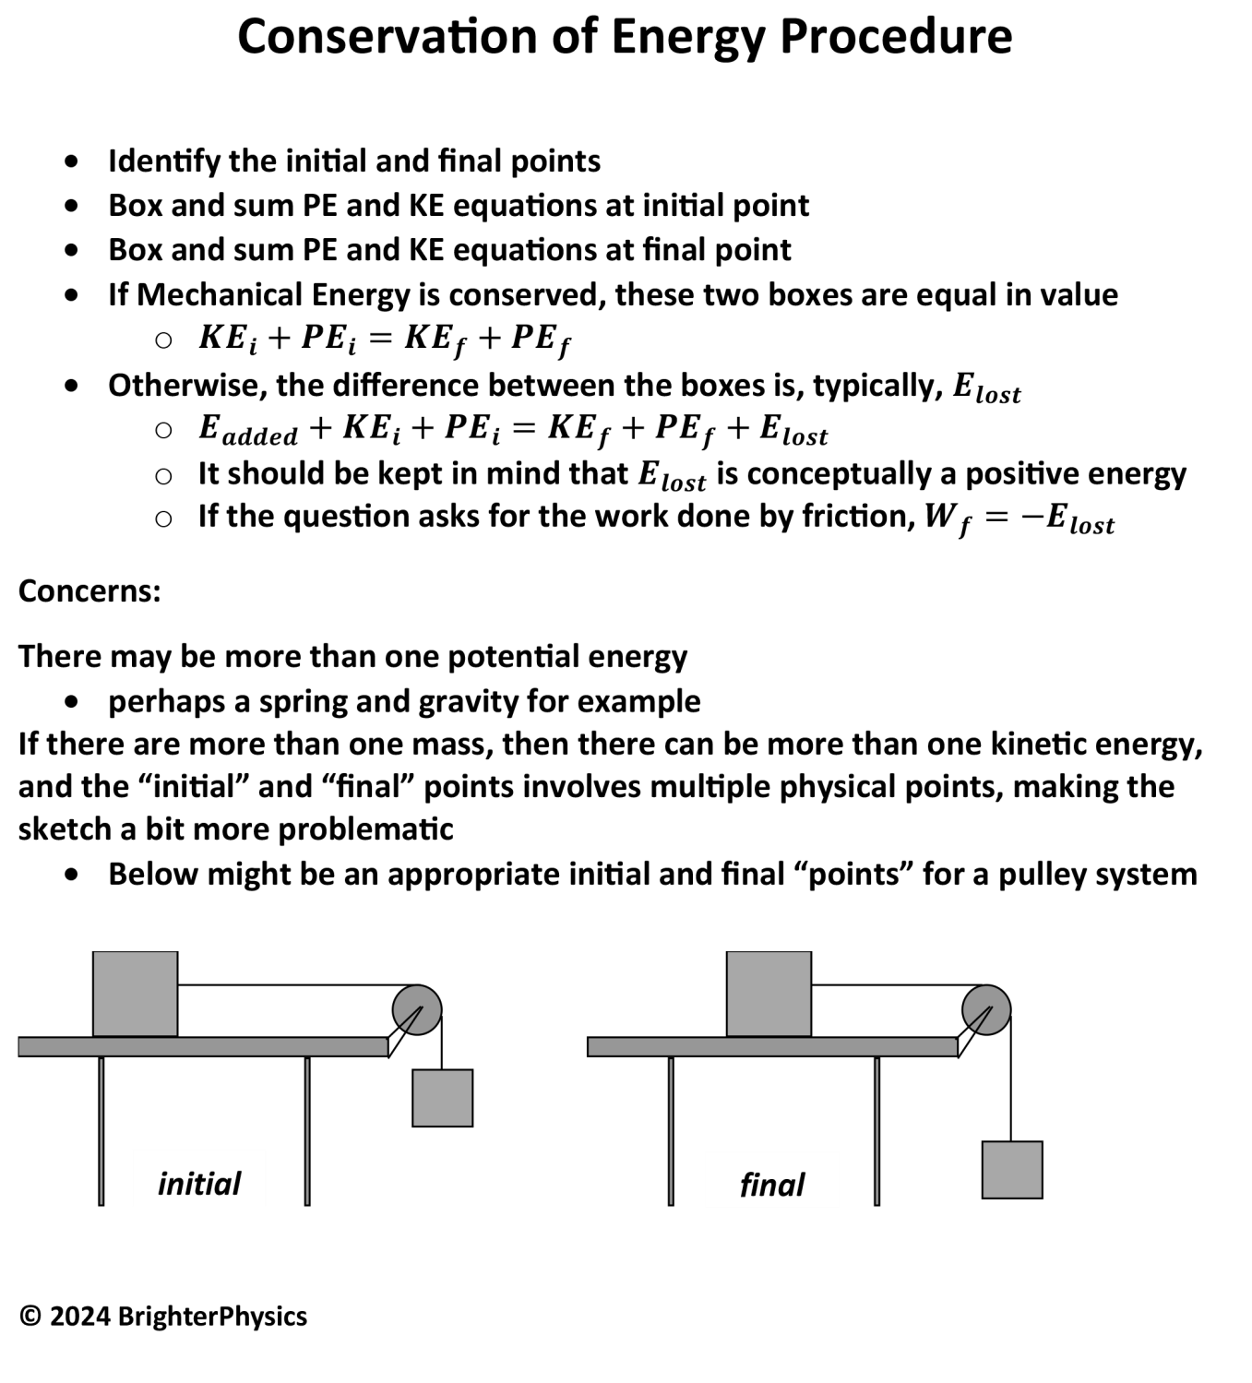
Energy Examples
@BrighterPhysics
Notes:
Both the internal and external force may be conservative forces. So, for instance, if the system is two carts on a frictionless ramp and the internal force is an ideal spring, then the PE from gravity and PE from the spring and the total KE add to a constant if there are no friction forces acting.

Slide 18
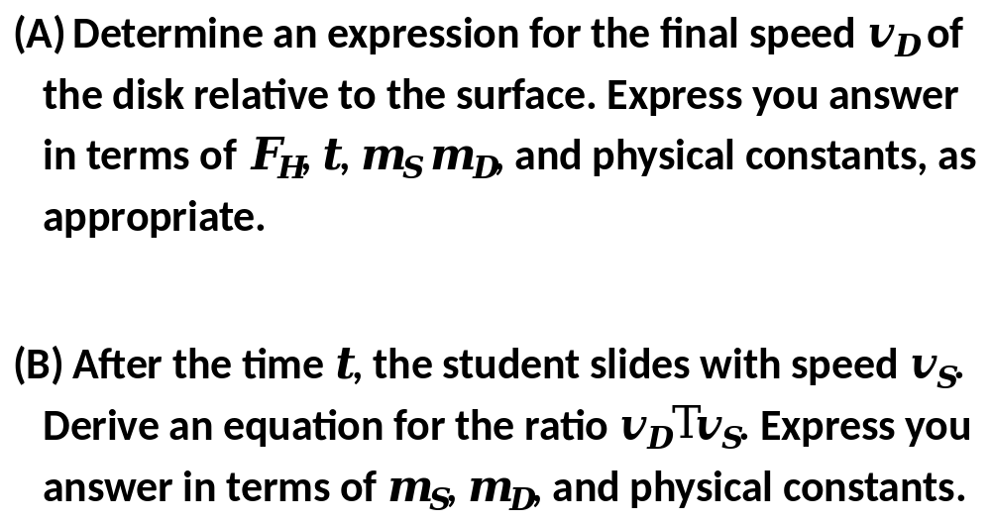
2021
AP Physics 1
Test
(modified)
Example
@BrighterPhysics
Notes:
These are the standard definitions that you can find in any peer reviewed Physics textbook. I have found not a single reference to a perfectly elastic collision in any of the college text that I have seen. Sure you can find differing definitions, such as definitions for perfectly elastic collisions, in many placed on the web – but you get what you paid for!

Slide 19

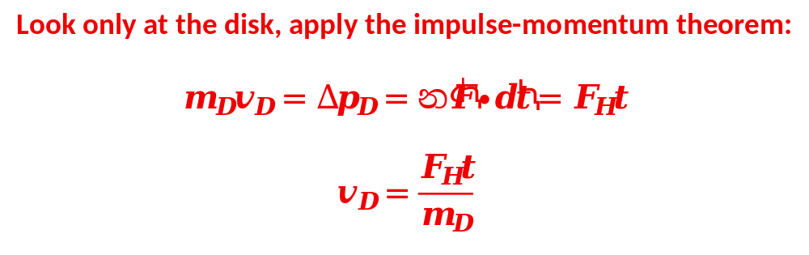
(A)
@BrighterPhysics
Notes:
Both the internal and external force may be conservative forces. So, for instance, if the system is two carts on a frictionless ramp and the internal force is an ideal spring, then the PE from gravity and PE from the spring and the total KE add to a constant if there are no friction forces acting.

Slide 20

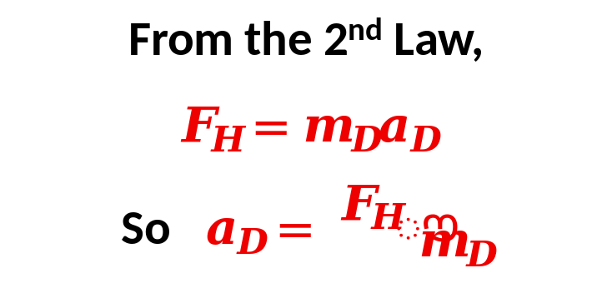
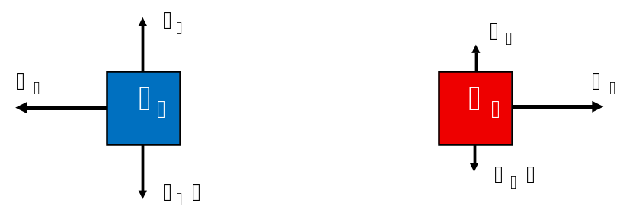
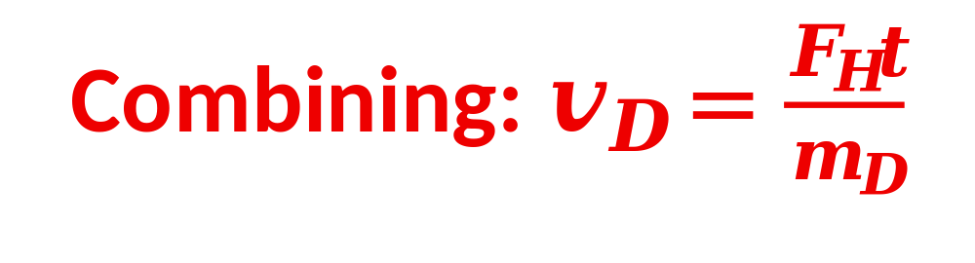
(A)alternate
@BrighterPhysics
Notes:
Both the internal and external force may be conservative forces. So, for instance, if the system is two carts on a frictionless ramp and the internal force is an ideal spring, then the PE from gravity and PE from the spring and the total KE add to a constant if there are no friction forces acting.

Slide 21
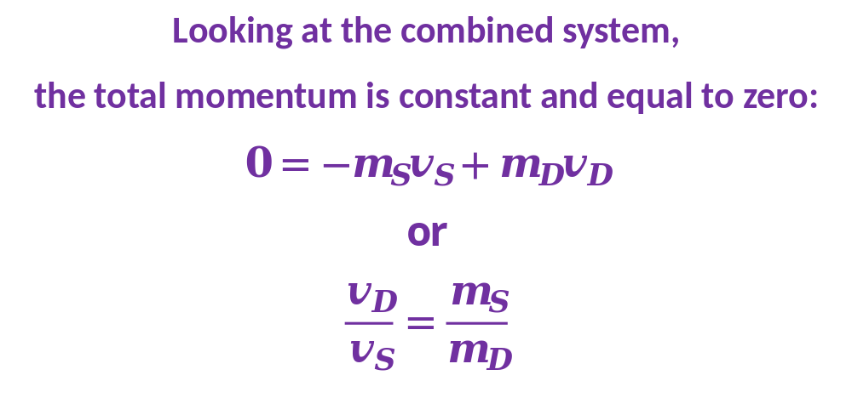
(B)
@BrighterPhysics
Notes:
Both the internal and external force may be conservative forces. So, for instance, if the system is two carts on a frictionless ramp and the internal force is an ideal spring, then the PE from gravity and PE from the spring and the total KE add to a constant if there are no friction forces acting.

Slide 22
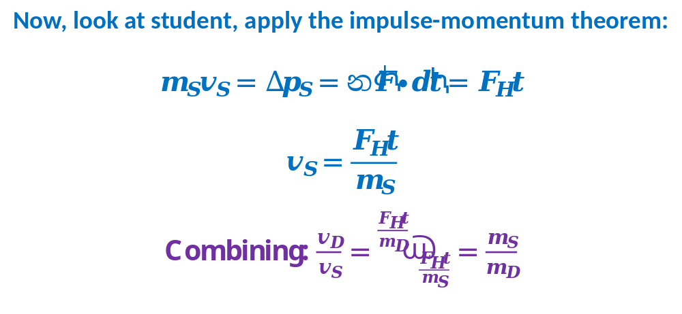
(B)alternate
@BrighterPhysics
Notes:
Both the internal and external force may be conservative forces. So, for instance, if the system is two carts on a frictionless ramp and the internal force is an ideal spring, then the PE from gravity and PE from the spring and the total KE add to a constant if there are no friction forces acting.

Slide 23
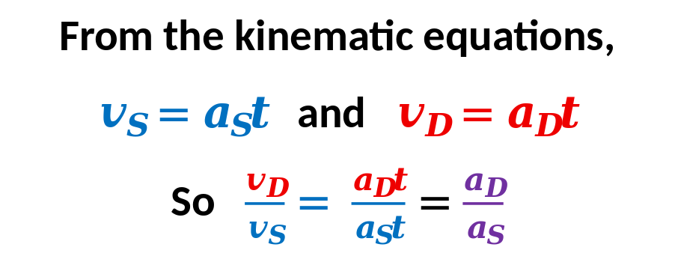
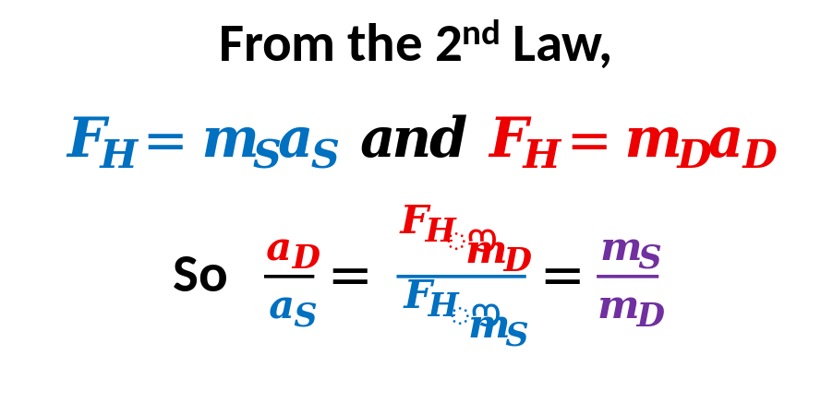
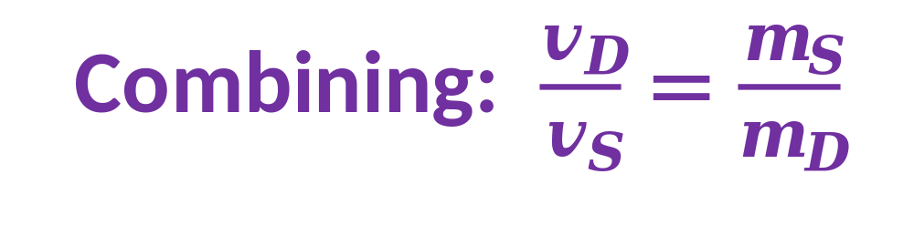
(B)alternate
@BrighterPhysics
Notes:
Both the internal and external force may be conservative forces. So, for instance, if the system is two carts on a frictionless ramp and the internal force is an ideal spring, then the PE from gravity and PE from the spring and the total KE add to a constant if there are no friction forces acting.

Slide 24

Visit
BrighterPhysics.org
For:
  More Details on Methodological Approach
  Free Versions of all AP 1 Units
  Access to Full Versions
Notes:
The internal forces always cancel in pairs. Only the external forces contribute to the net force.

