Slide 1
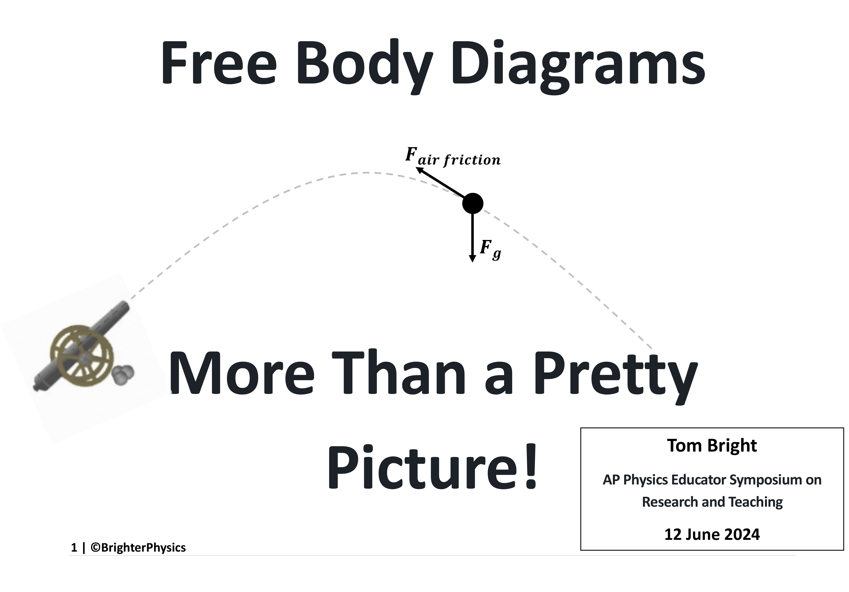

Slide 2
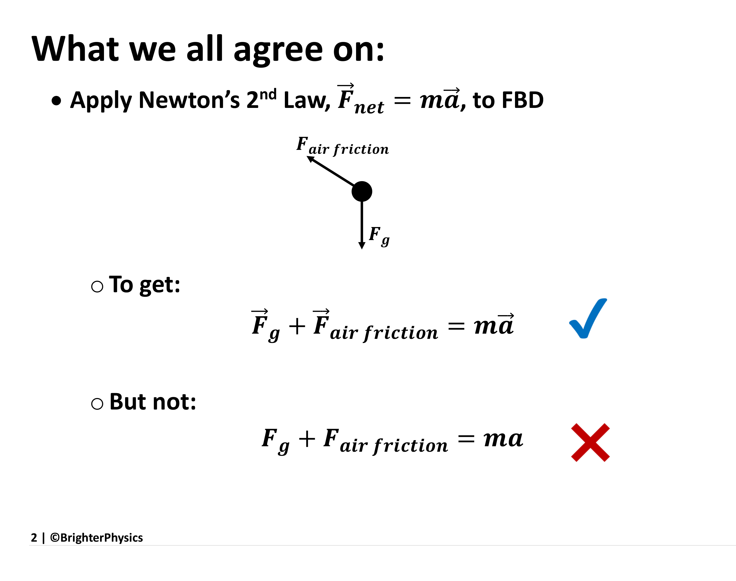
Notes:
Newton’s 2nd Law is inherently a vector equation.

Slide 3
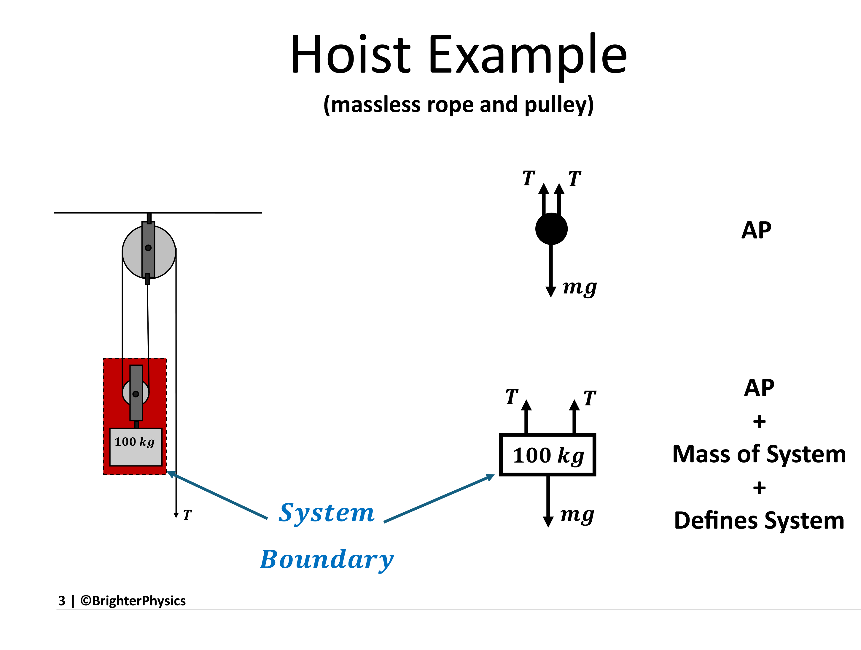
Notes:
Newton’s 2nd Law applied to either diagram gives 2T-mg = ma. The second diagram, however, unambiguously defines what makes up the system: the 100 kg mass AND the biottom massless pulley AND the potion of the rope enclosed within.

Slide 4
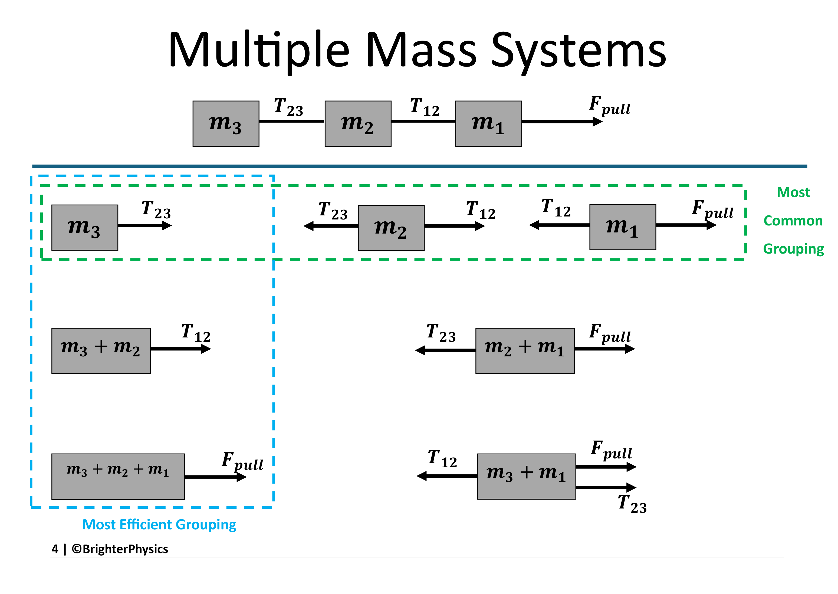
Notes:
Seven different systems can be identified when there are three masses.

Slide 5
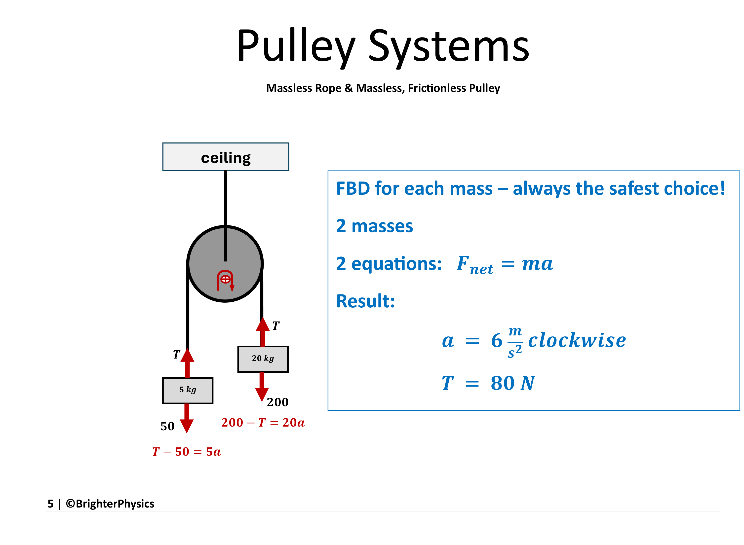
Notes:
For two masses, three separate FBD can be defined.

Slide 6
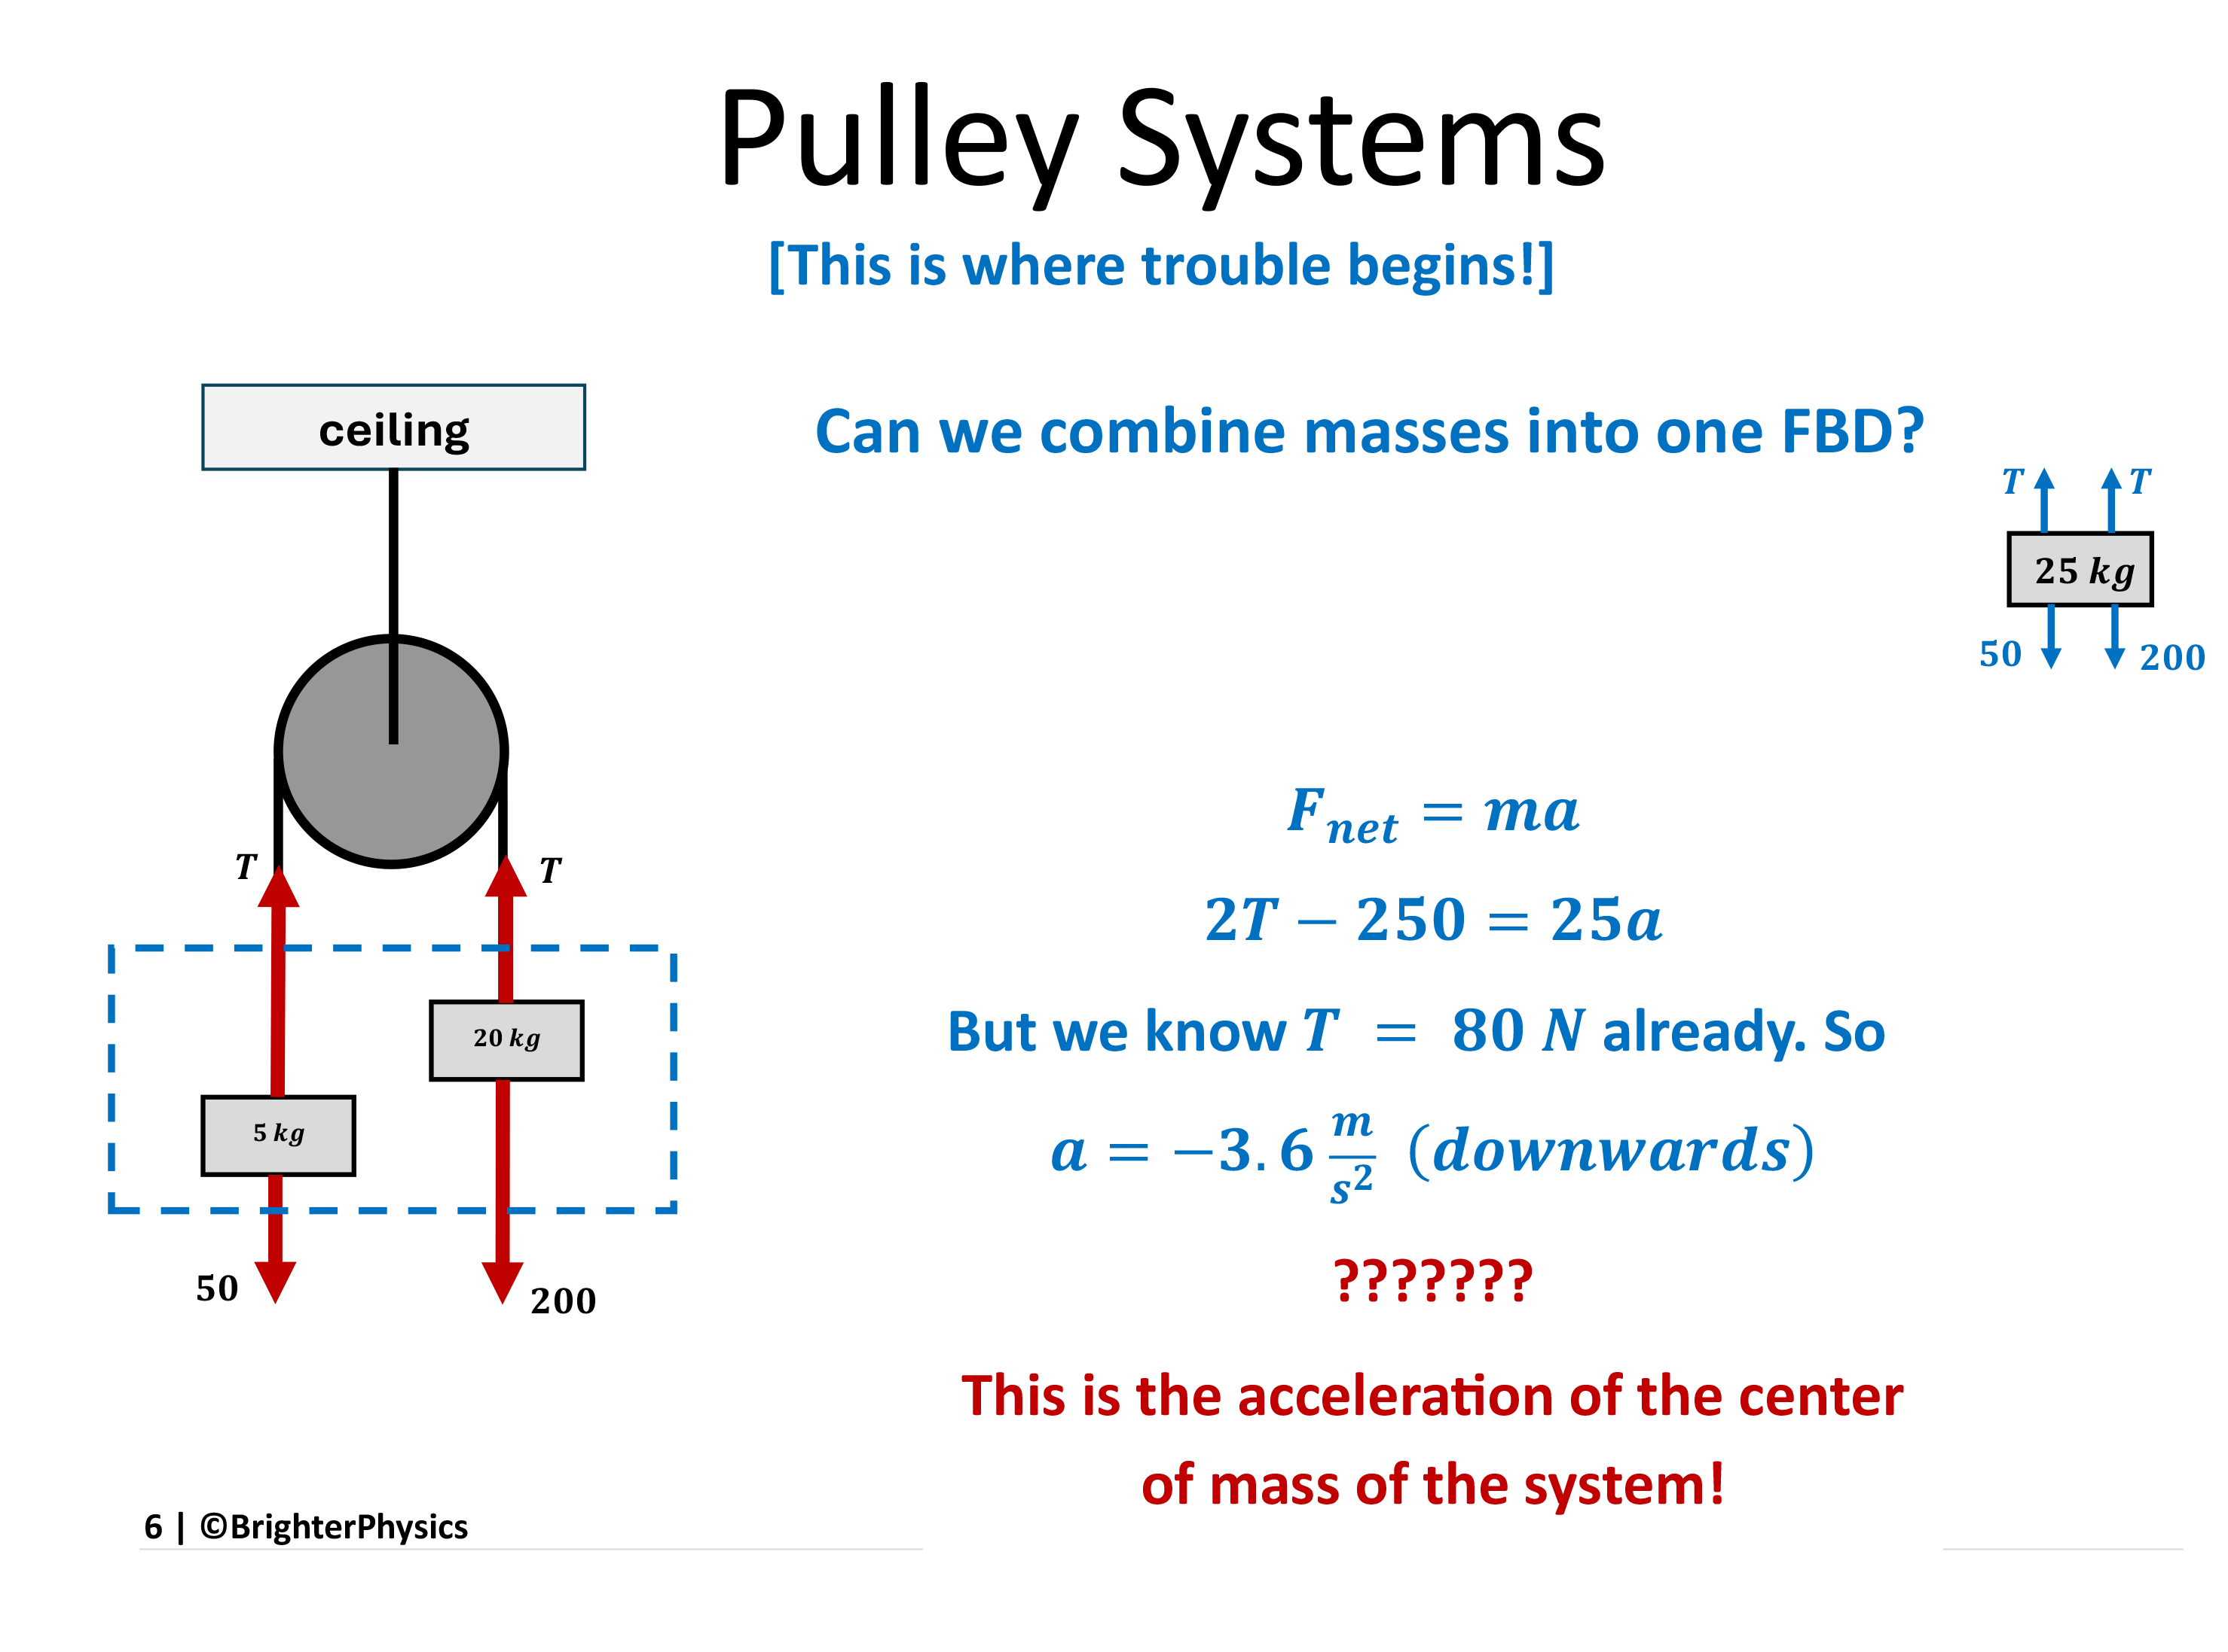
Notes:
Without drawing the FBD, many will write Fnet=ma followed by (m2-m1)g = (m1+m2)a and come up with the magnitude of the acceleration of 6m/s^2. This may give the correct answer, but the Physics is WRONG! See slide 14.

Slide 7
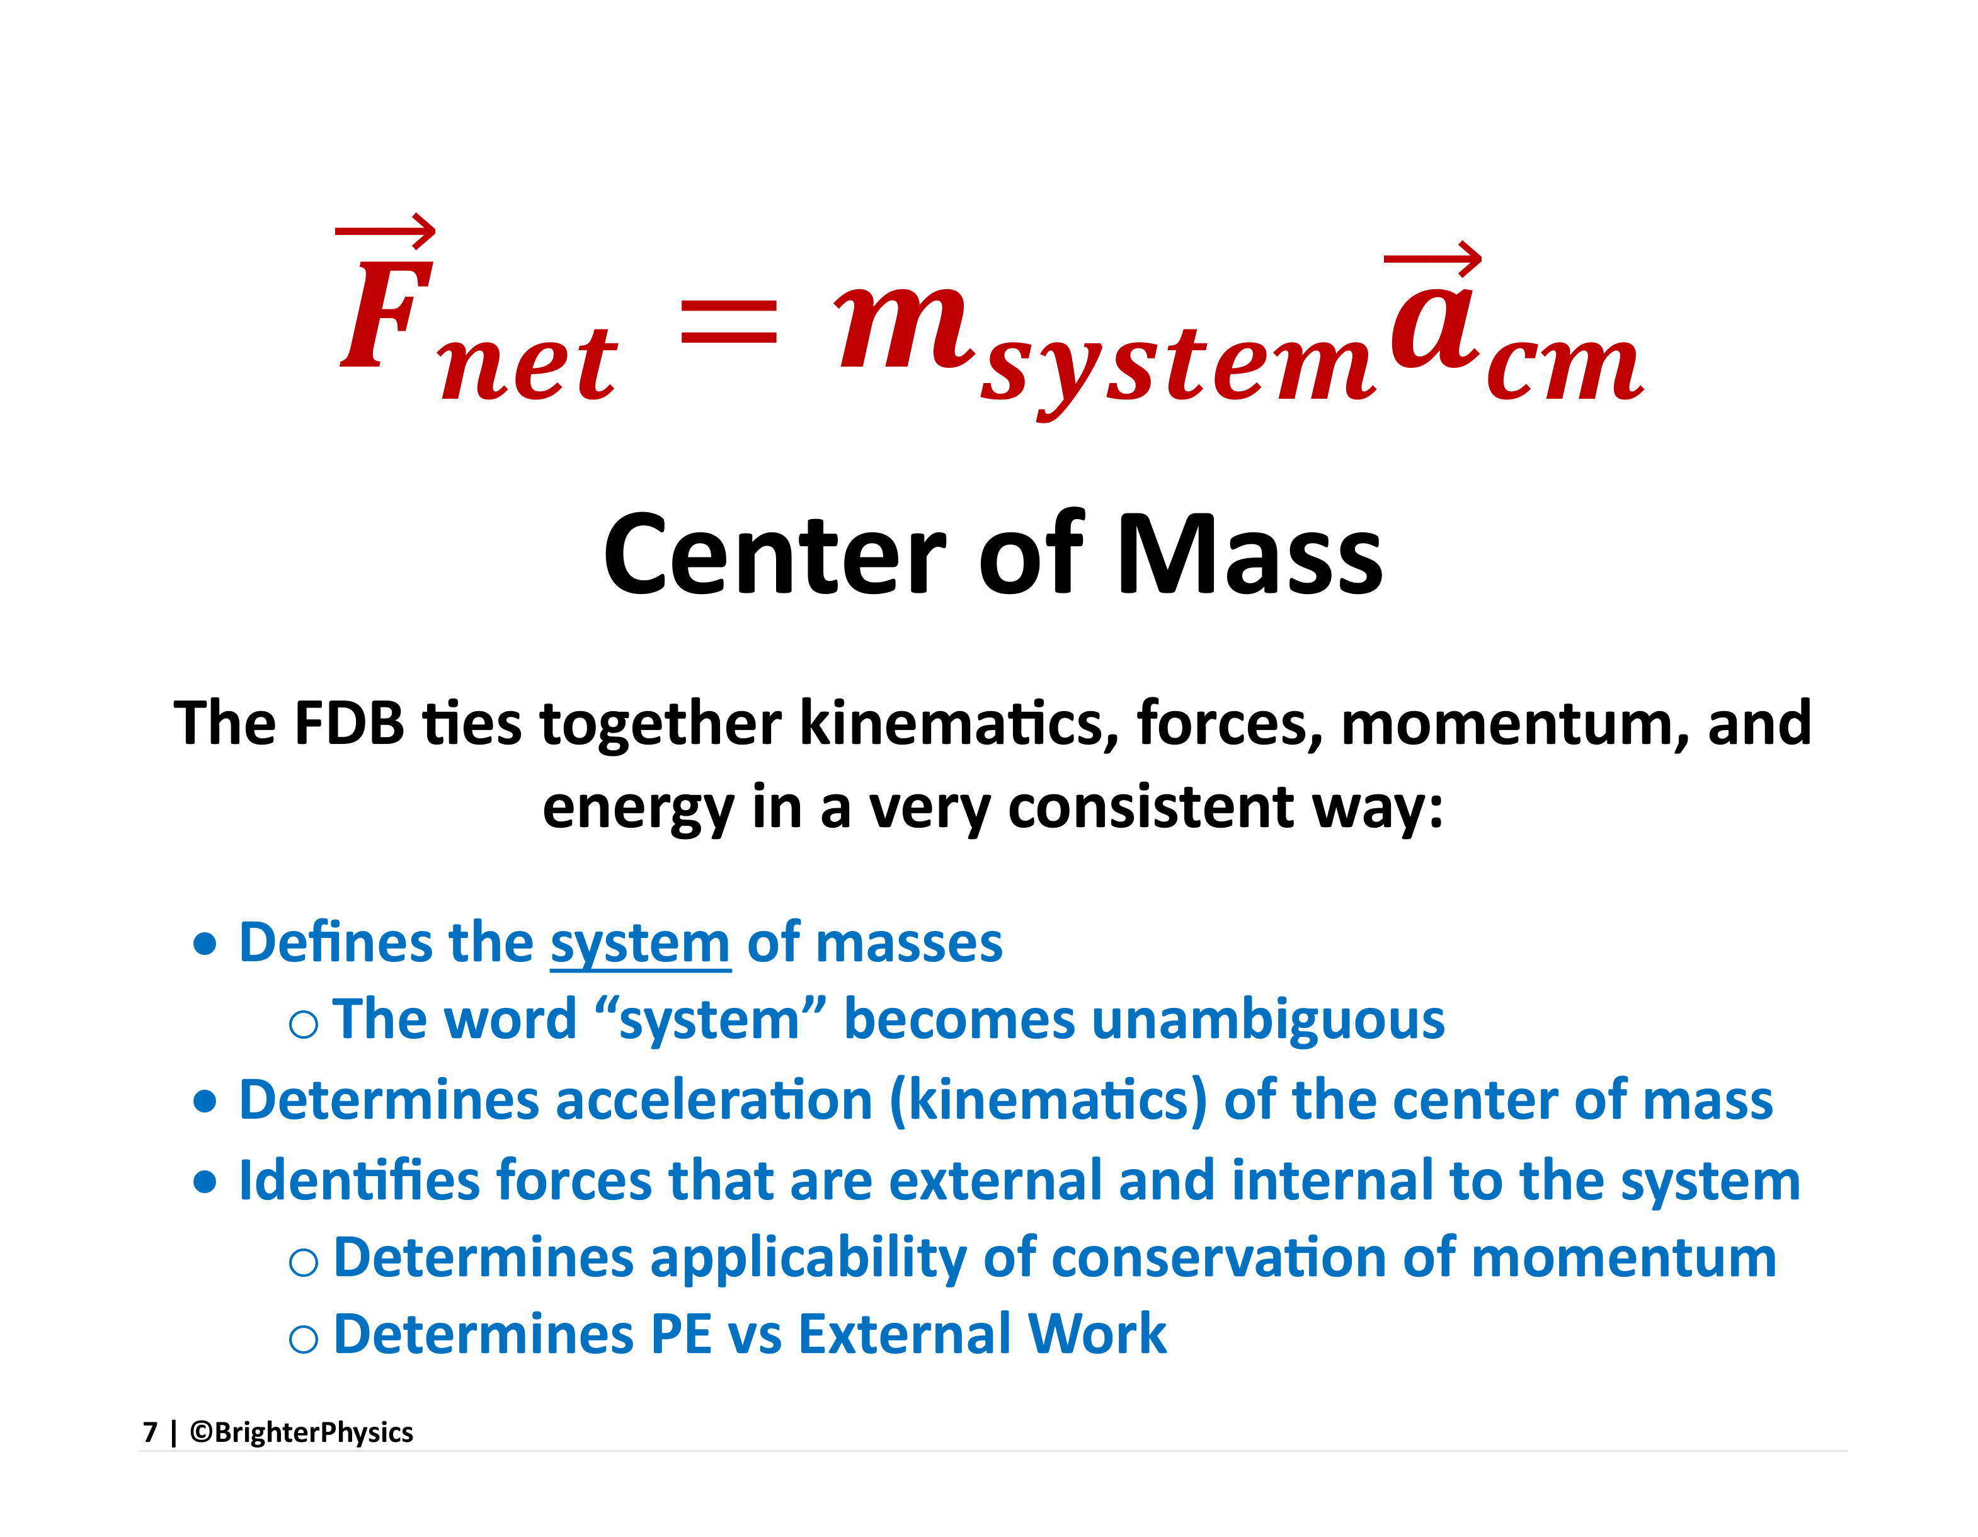

Slide 8
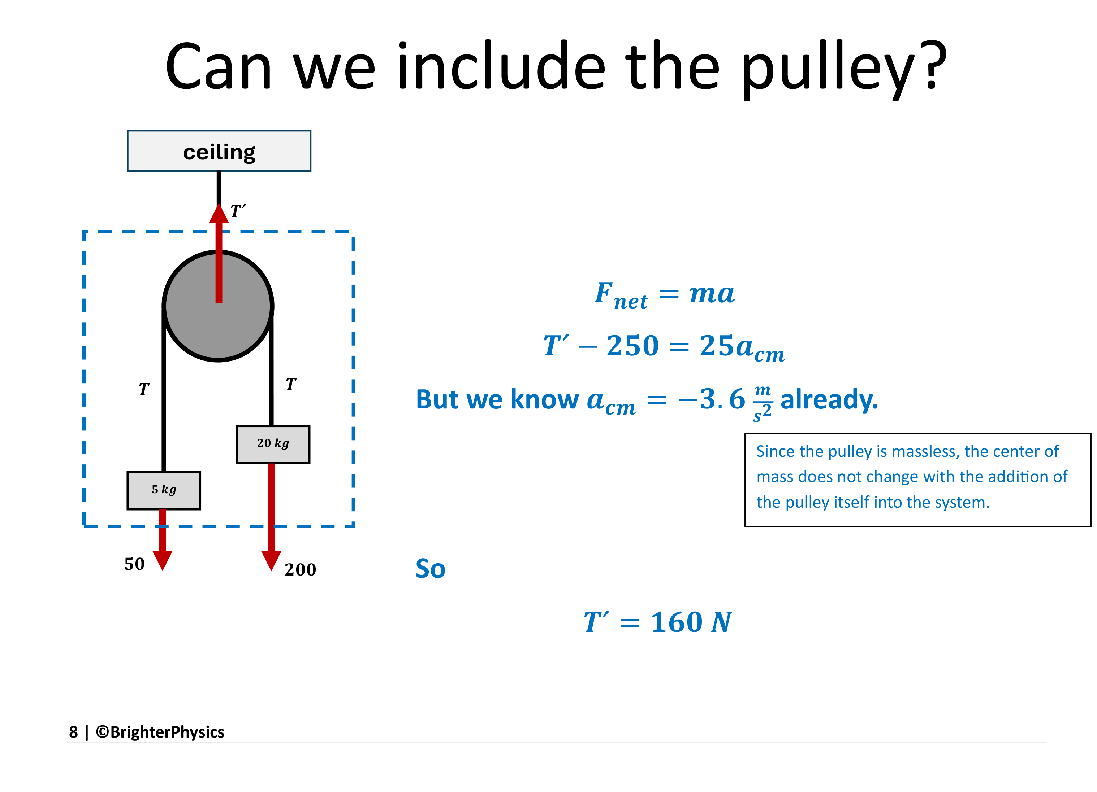

Slide 9
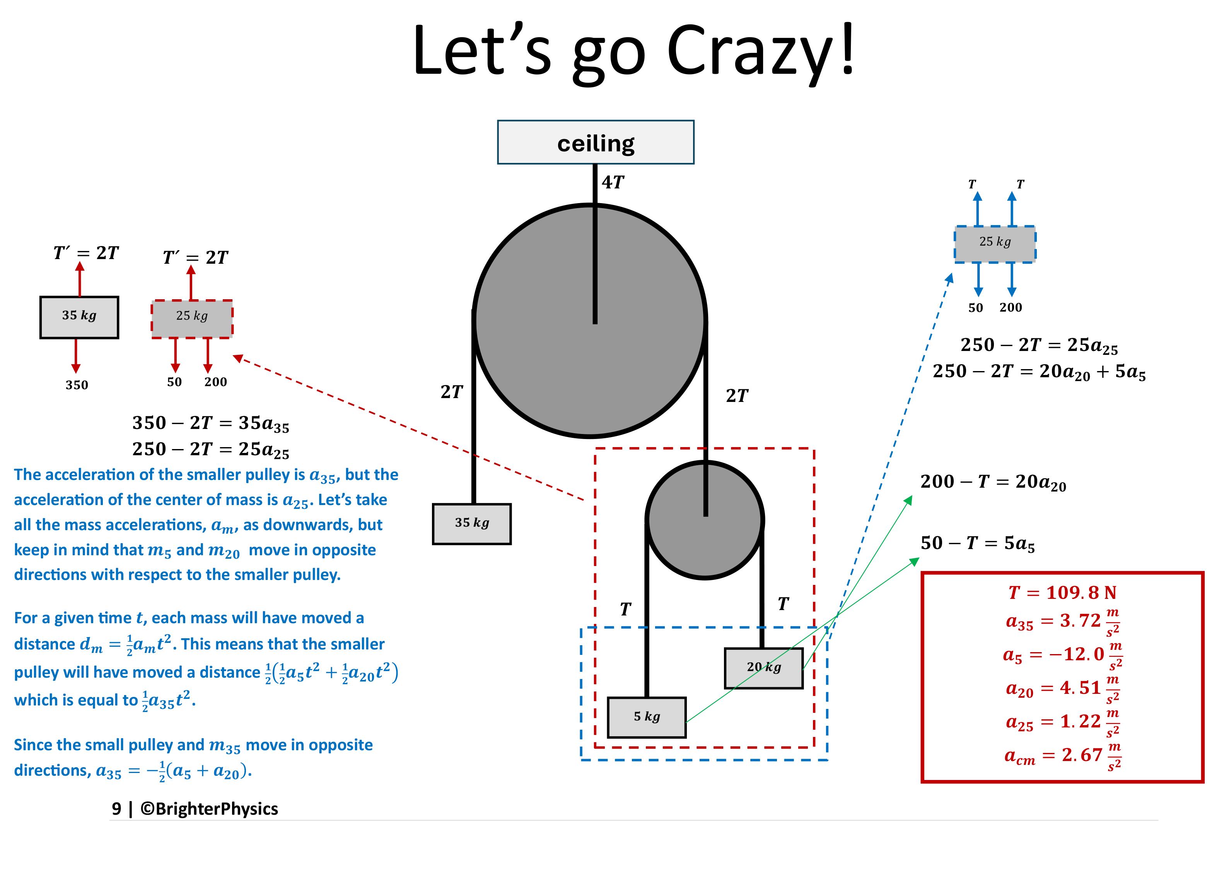

Slide 10
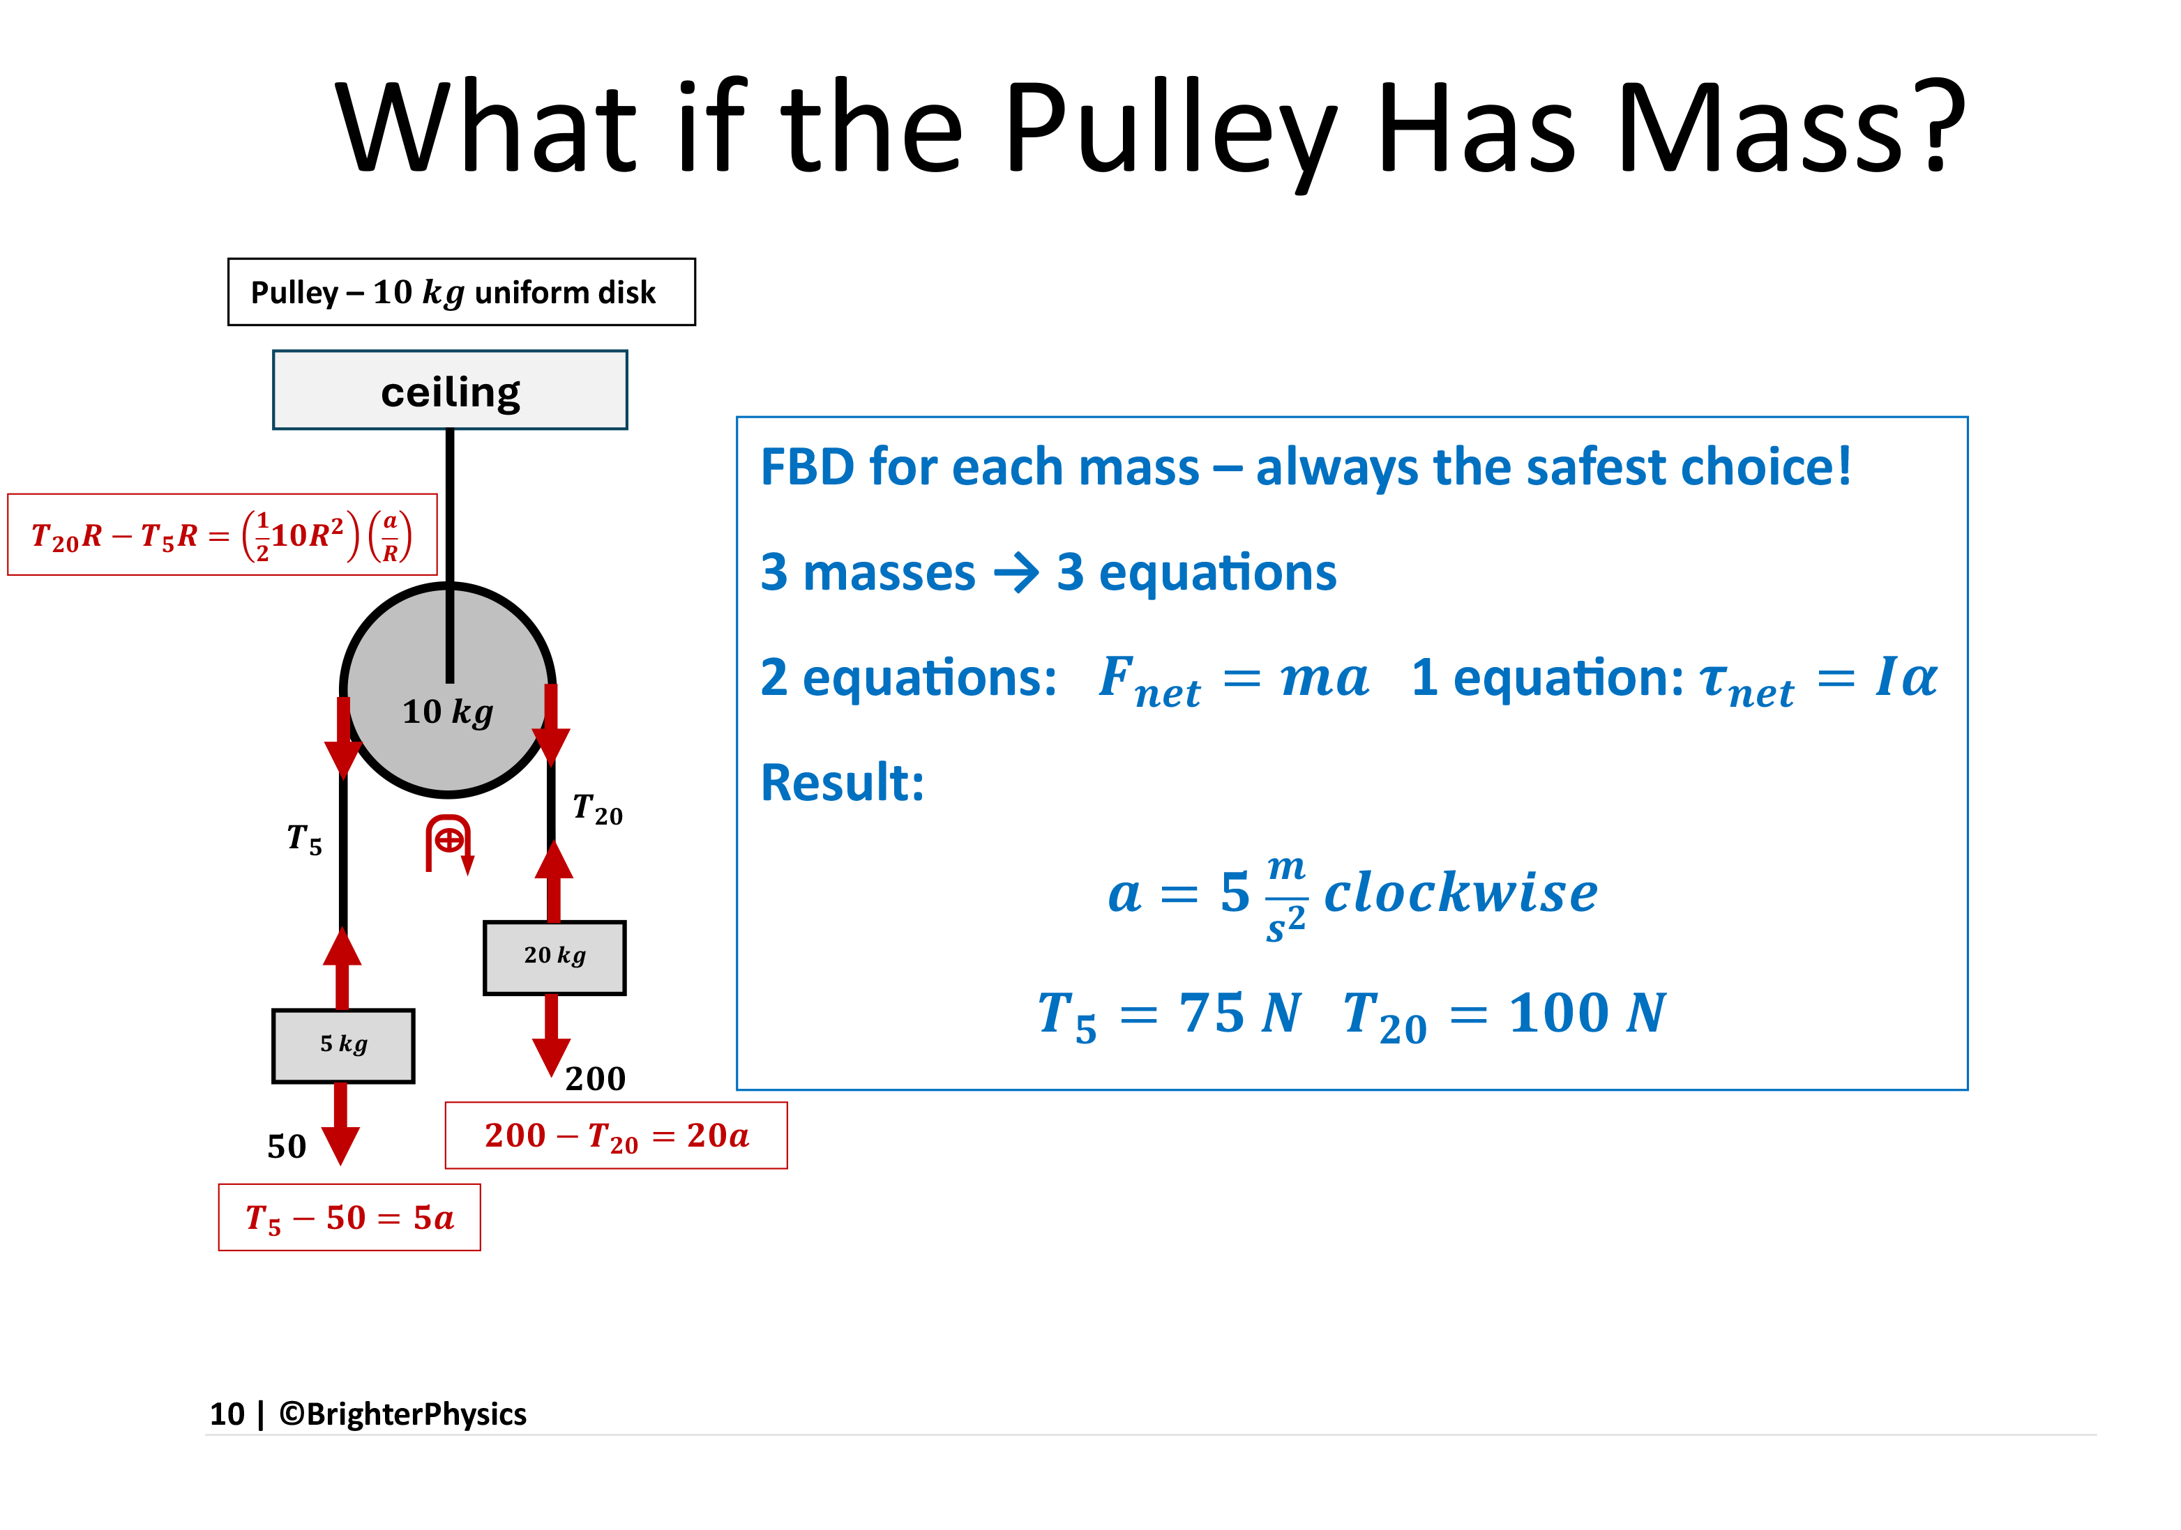

Slide 11
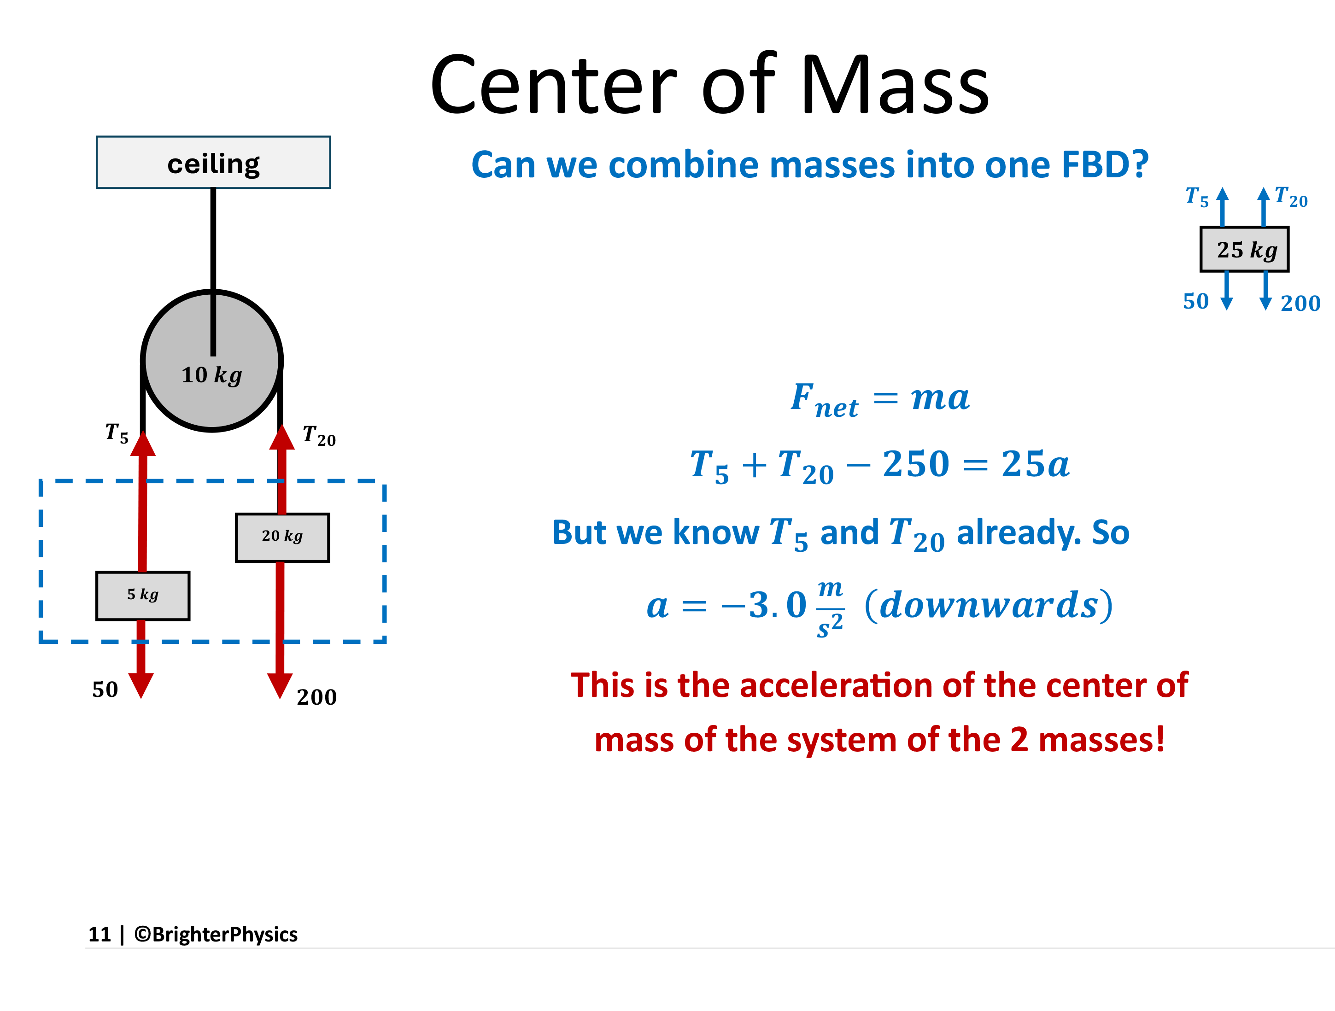

Slide 12
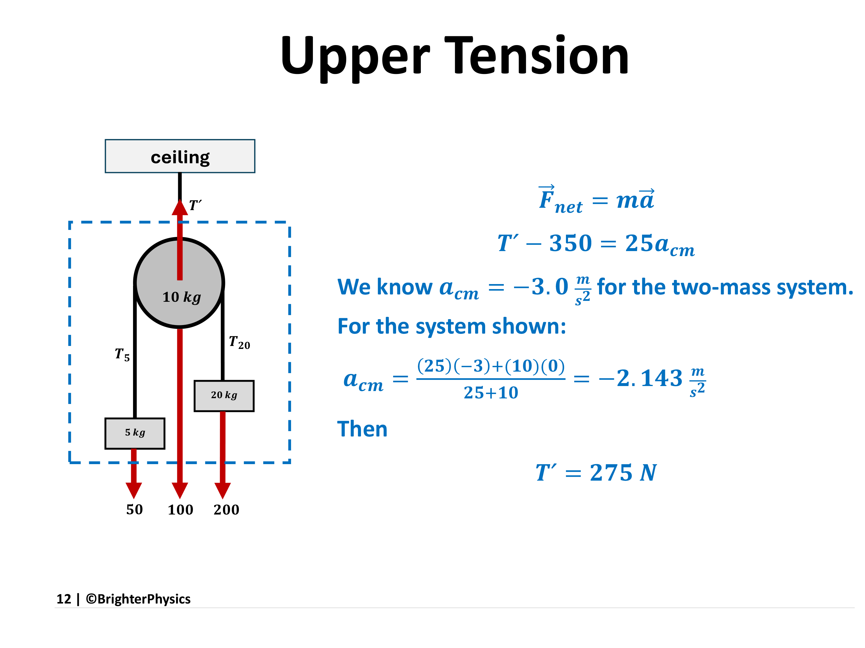

Slide 13
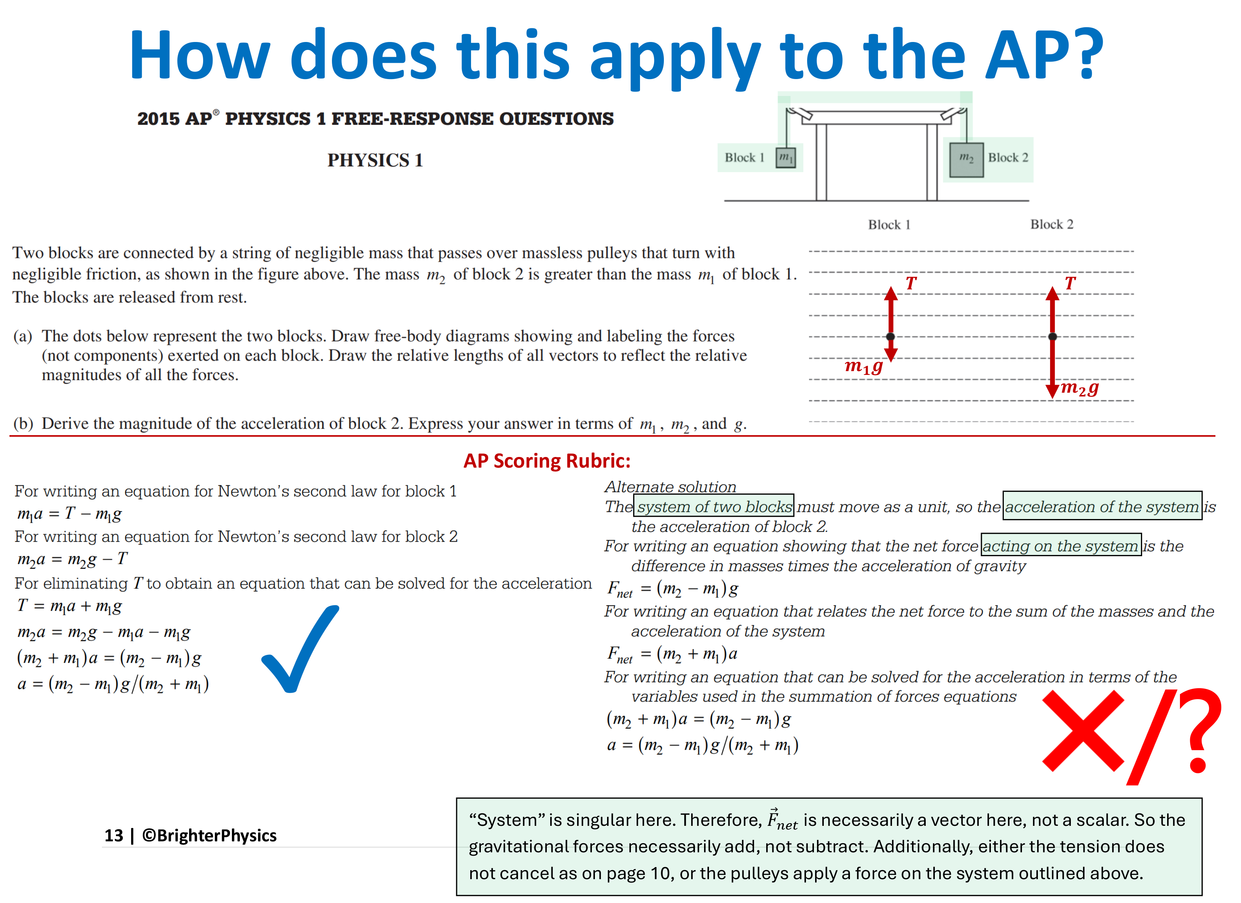
Notes:
The solution at left is absolutely correct. The alternate solution at right is just bad physics – it identifies THE system as the two masses, ignoring the tensions that are acting, and ignoring the vector nature of the 2nd law. It is a shortcut that can be used by experienced practitioners who know why it works, but it should never be taught to students.

Slide 14
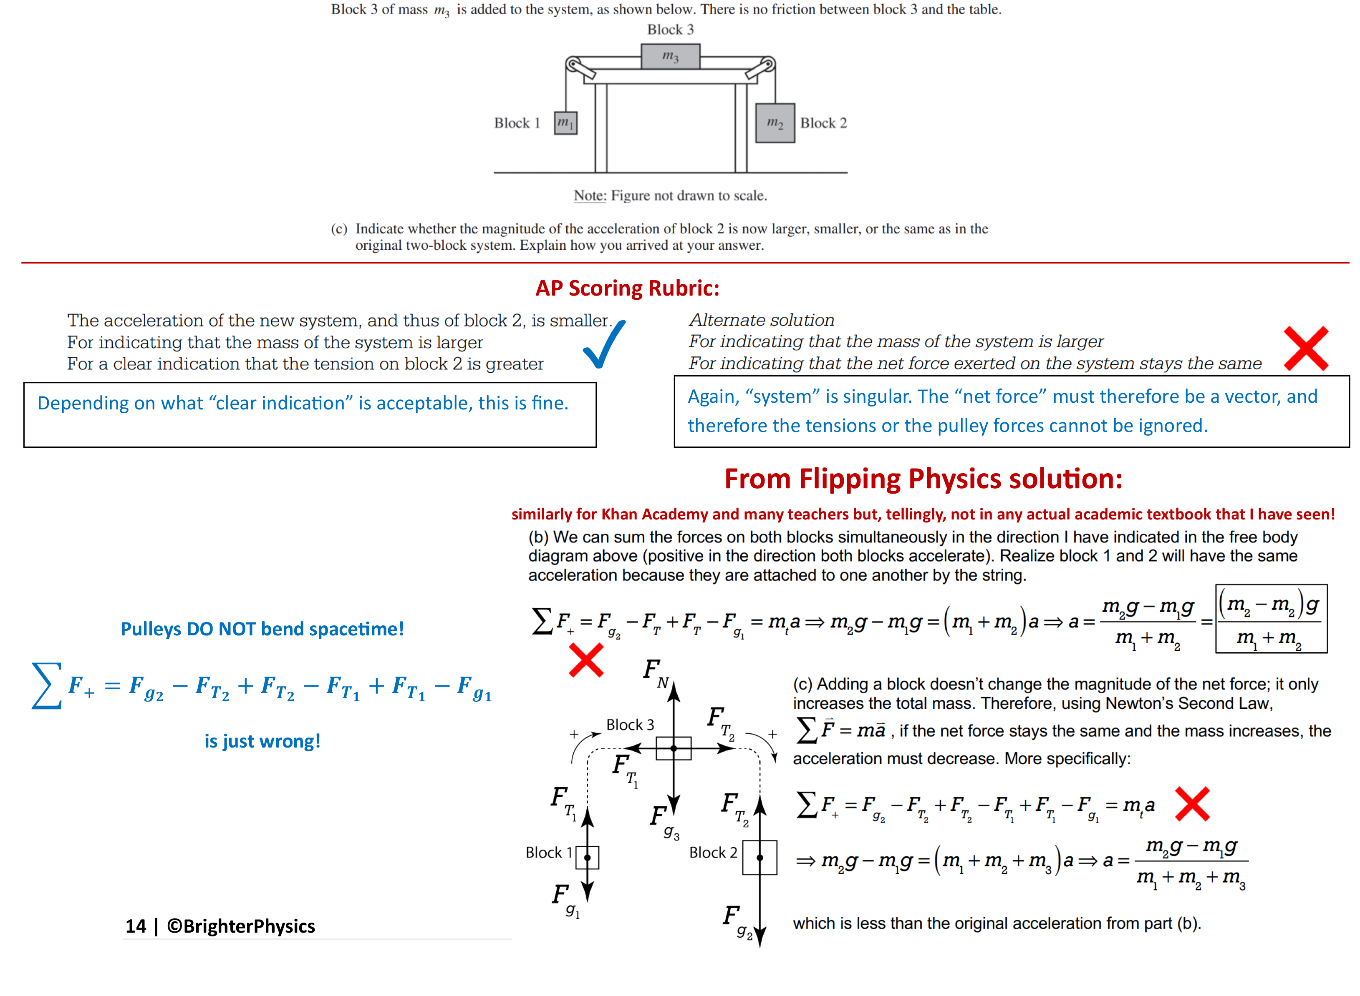
Notes:
The Flipping Physics solution, which is patently incorrect usage of the 2nd law, makes explicit what the shortcut entails. It explicitly write the 2nd law as a vector in part (c), but then ignores the vectoral nature by cancelling the internal (?) tension forces even though they are clearly perpendicular.

Slide 15
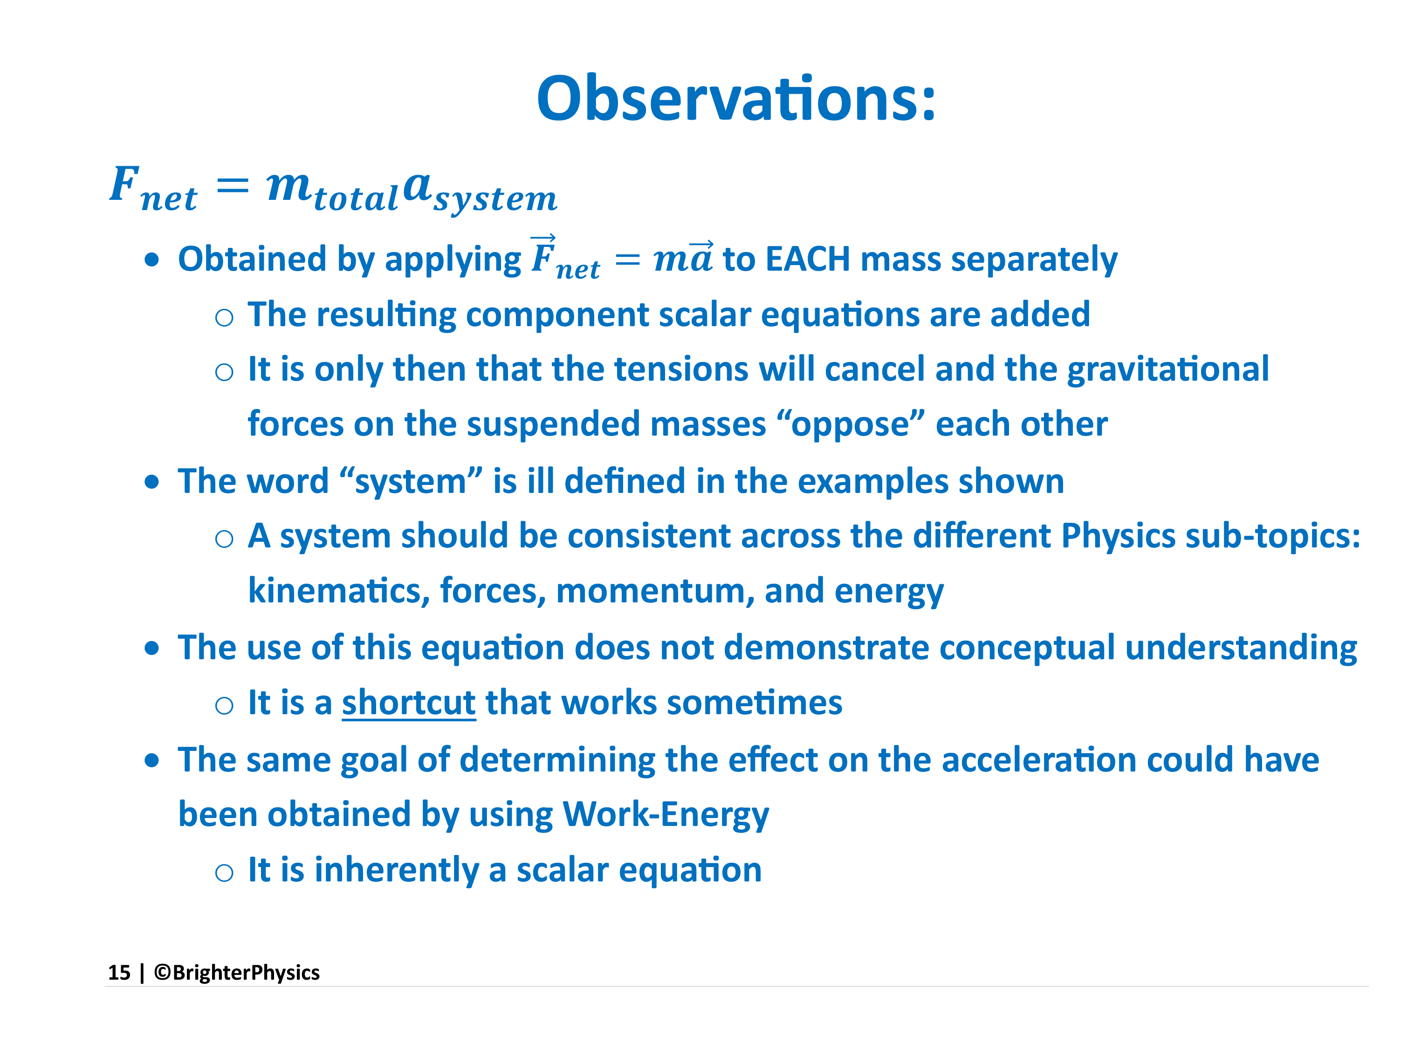

Slide 16
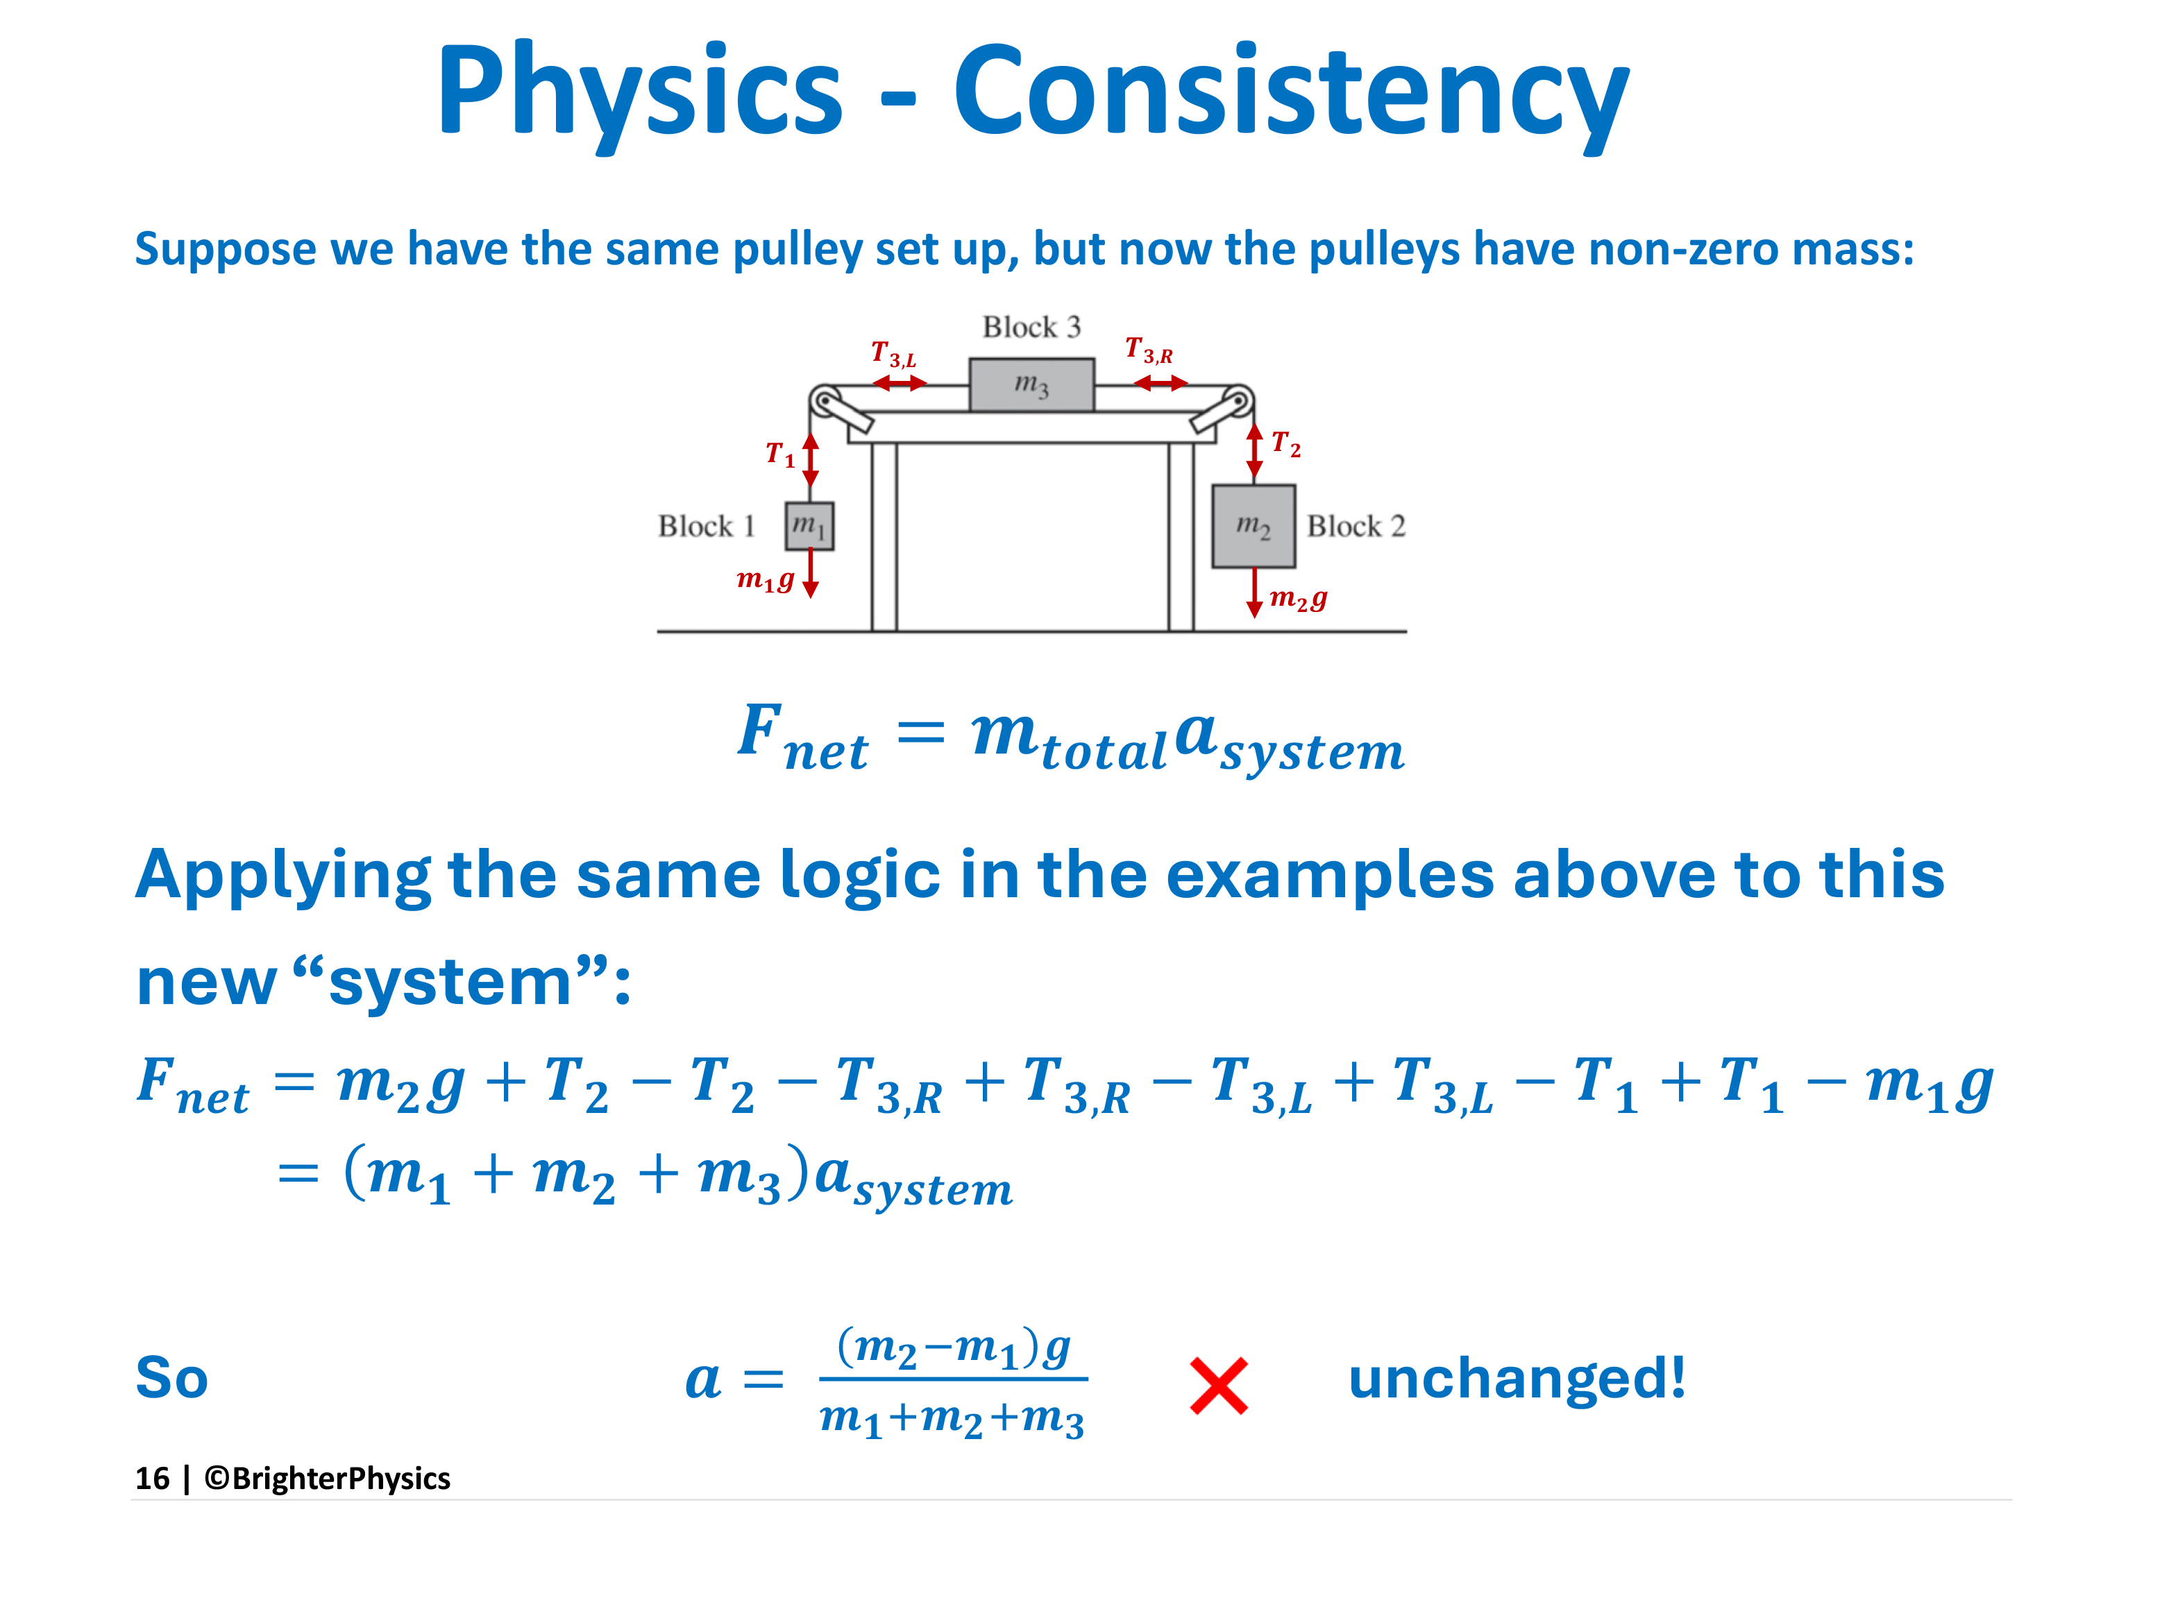
Notes:
The (incorrect) answer here would be the result of a “student” applying the shortcut on the previous slides to this more complicated problem. An experienced practitioner would realize that the acceleration will not be the same as the previous slide because of the massive pulleys and would therefore know to apply the rotational 2nd law to each pulley, and the 2nd law to each mass separately.

Slide 17
